Slide 1
Session 1414:
DevOps and Cloud Service Management and Operations Mini-Bootcamp
Pam Geiger
Jim Palistrant
Bluemix Learning & Skills

Slide 2
Please note
IBM’s statements regarding its plans, directions, and intent are subject to change or withdrawal without notice at IBM’s sole discretion.
Information regarding potential future products is intended to outline our general product direction and it should not be relied on in making a purchasing decision.
The information mentioned regarding potential future products is not a commitment, promise, or legal obligation to deliver any material, code or functionality. Information about potential future products may not be incorporated into any contract.
The development, release, and timing of any future features or functionality described for our products remains at our sole discretion.
Performance is based on measurements and projections using standard IBM benchmarks in a controlled environment. The actual throughput or performance that any user will experience will vary depending upon many factors, including considerations such as the amount of multiprogramming in the user’s job stream, the I/O configuration, the storage configuration, and the workload processed. Therefore, no assurance can be given that an individual user will achieve results similar to those stated here.

Slide 3
https://github.com/bluemix-enablement/ic171414

Slide 4
Agenda
DevOps and Cloud Service Management and Operations (CSMO) Overview
CSMO Bluemix Garage Offering
Build to Manage
Hands on Lab

Slide 5
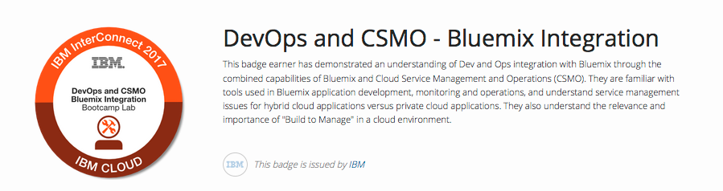
EARN YOUR IBM OPEN BADGE! IBM InterConnect Bootcamp Labs
http://ibm.biz/badging

Slide 6
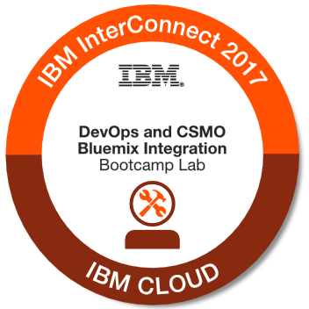
EARN YOUR IBM OPEN BADGE!
Open Badges: DIGITAL Credentials for the modern workforce
Digital emblem symbolizes micro-skills
Contains metadata with skills tags and accomplishments
Easy to share in social media: LinkedIn, Twitter, FB, Blogs
Tethered to the issuer for verification and validation
Standards-based on Open Badge Infrastructure (OBI) standards
You will be issued your badge within 24 hours following full completion of this Bootcamp Lab
You will receive an email from admin@youracclaim.com containing instructions for accepting and claiming your badge
http://ibm.biz/badging
@david_leaser

Slide 7
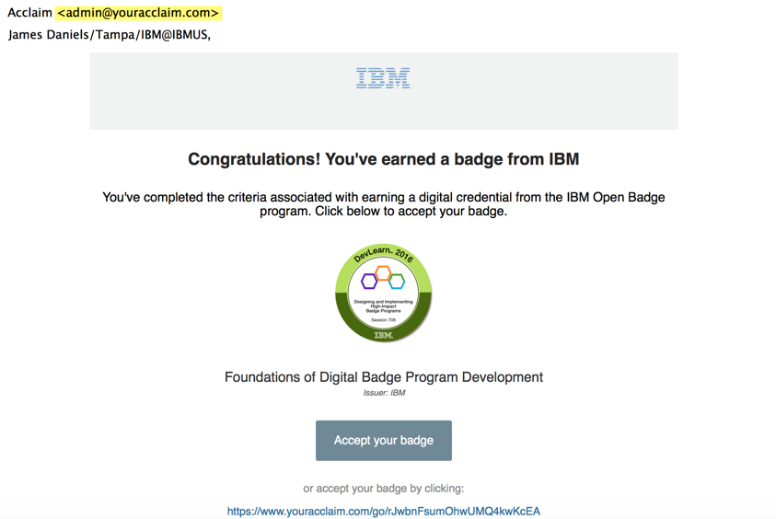
YOUR 10 STEP PLAN
EARN YOUR IBM OPEN BADGE!
DevOps and CSMO - Bluemix Integration
http://ibm.biz/badging
@david_leaser

Slide 8
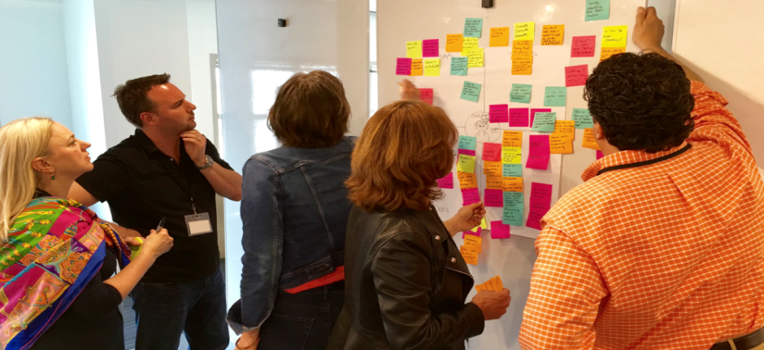
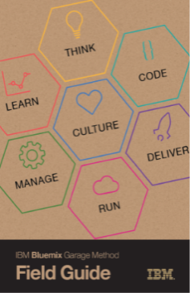
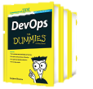

Jump-start your digital transformation with a DevOps Workshop!
Reserve Your Seat Now!
Day and Date | Start Time | Workshop Title | Facilitators
Mon, Mar 20 | 3:30 pm | Apply Design Thinking to Accelerate DevOps | Sarah Plantenberg Chris Lazzaro
Tue, Mar 21 | 11:30 am | Hold Your Horses or Let Them Run Wild? A Financial Institution’s DevOps Journey | Peter Eeles David Zimmerman
Tue, Mar 21 | 2:15 pm | Get on the Bandwagon for Digital Transformation with DevOps | Sanjeev Sharma
Tue, Mar 21 | 4:00 pm | Get Mapped – Lean Value Stream Mapping for DevOps | Mustafa Kapadia
Wed, Mar 22 | 8:30 am | Continuous Delivery of Software Innovation in Today's Complex Multi-Speed IT World | Al Wagner Eric Minick
Wed, Mar 22 | 10:30 am | Get a SAFe® Agile Release Train Up & Running in an Hour | Amy Silberbauer Bhawana Gupta
Wed, Mar 22 | 1:00 pm | Simplify DevOps Transformation with IBM Bluemix Continuous Delivery and Garage Method | Chris Lazzaro Michael Elder
Wed, Mar 22 | 3:00 pm | Mainframe DevOps: Managing the Cultural Divide | Rosalind Radcliffe
Thu, Mar 23 | 8:30 am | Managing Multi-Cloud Environments with Ease | Shajeer Mohammed Jose Ortiz
Thu, Mar 23 | 10:30 am | Shift Application Performance Management Left in the DevOps Lifecycle | Arun Biligiri
90 min Lean Coffee format workshops with hands-on exercises
Led by IBM DevOps experts and thought leaders
Share your experience in dealing with key DevOps challenges
Complimentary DevOps for Dummies book set and IBM Bluemix Garage Method Field Guide
Location: Reef Ballroom D, Mandalay Bay
Seating is limited: RSVP at http://bit.ly/ibmworkshops or Text Jon Ward at (919) 357-2239
Notes:
the “Lean Coffee” format where participants gathered, built an agenda, and began discussing DevOps topics that were pertinent to their particular environment.

Slide 9
DevOps and CSMO Overview

Slide 10

“Spine” for Cloud Service Management and Operations
Completeness of Lifecycle
Ingo Averdunk
Distinguished Engineer, IBM Cloud
Richard Wilkins
Distinguished Engineer and CTO IBM ASEAN, IBM Cloud
Depth of understanding &
validation
v1
January 22, 2017

Slide 11
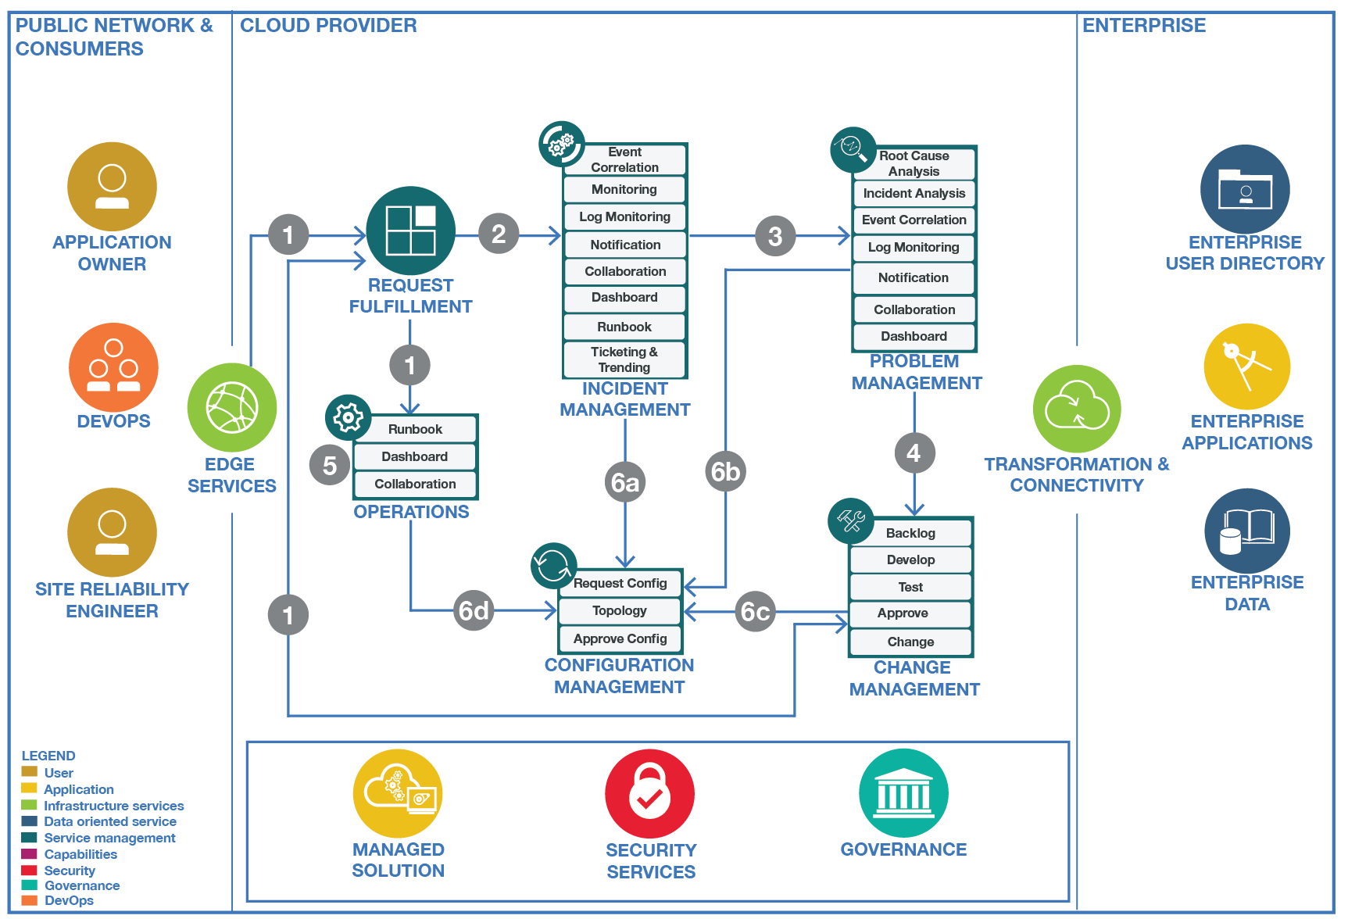
Cloud Service Management and Operation
Operations Transformation
Cloud Service Management and Operations refers to the entirety of activities – organized in persona, processes, and tools – that are performed by an organization to plan, design, deliver, operate and control IT and Cloud services offered to customers..
Assure Availability and Performance of applications running on the IBM Cloud platform, given the target SLA of 99.99% availability for applications
Reduce mean-time-to-repair to restore service as quickly as possible
Managing and controlling operational risks and threats
Incident Management
Problem Management
Change Management
Dashboarding & Reporting
Operations
Compliance
Build to Manage
Release Management
Configuration Management
Service Continuity
Performance & Capacity Management
Service Level Management
Financial Management
Business Performance
Continued Service Improvement

Slide 12
Cloud Service Management – Where to start ?
Operations Transformation
Core These are the core practices of Cloud Service Management and Operations that most companies have to follow right from the beginning of the transformation to cloud. These practices assure availability and visibility of services. An example is Incident that rapidly restores the service, while Problem Managment identifies the root-cause and prevents the reoccurances of these incidents.
Scale As the cloud adoption increases, these practices need to be followed to scale with the growing demand. They align parallel activities performed by other entities with the needs of Service Management. For instance, Developers build manageable micro-services.
Service-orientation These practices add a service-oriented view and business-focus to Service Management. Activities are now strongly aligned with SLAs and business KPIs. As an example, business performance information is visualized in dashboards and used to prioritize operational activities.
Incident Management
Problem Management
Change Management
Dashboarding & Reporting
Operations
Compliance
Build to Manage
Release Management
Configuration Management
Service Continuity
Performance & Capacity Management
Service Level Management
Financial Management
Business Performance
Continued Service Improvement

Slide 13
Cloud Service Management and Operation

Slide 14
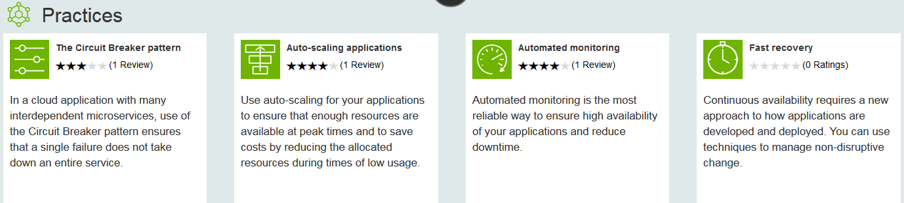
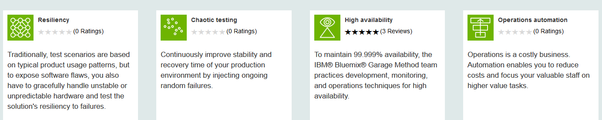
Operations Transformation
Optimize Service Management through DevOps culture and Cloud Computing
Change in mindset:
Flexibility before Efficiency; IT philosopy is „Yes“; Decentralized Governance
Accept failures as fact, need for graceful recovery
New Practices
Automation everywhere
Highly collaborative operations, “ChatOps”
Traditional Roles change: DevOps, EnvOps, First Responder, Site Reliability Engineers
Processes change: from Change & Release Management to Continuous Delivery

Slide 15

Operations Transformation – Organizational Change
Traditional
Enterprise IT
Co-exist
Large Enterprise
Moving to Cloud
Small
Startup
Enterprise DevOps teams – delivering Microservices as full-stack deployments. Design tor resiliency, testing, QA.
Full Stack DevOps Team
Dev – app development, deploy, test…(note: QA team omitted to keep simple)
join
Ops – Services & middleware:
request driven provisioning,
configuration, patch..
Site Reliability Engineers / Environment Ops - Centralized policy, governance, audit.
Ensure org compliance policy, interface with cloud provider, First Responders, define acceptance criteria for new Microservices, and automated tests, audits, triage.
split
Ops – infrastructure: Procurement, provisioning, OS patch, etc.
Third party cloud provider (ex: IBM)
Third party cloud provider (ex: IBM)
Application
Services / Middleware
DevOps personas need a view of their project
SRE / Environment Ops personas need a view across multiple DevOps teams
Traditional IT Ops needs view across both traditional and cloud environments
Infrastructure

Slide 16
Operations Transformation – Relationship of CSMO and DevOps
ITIL ?
NoOps ?
SRE
aaS
DevOps
Development
IT Operations
EnvOps
Cloud Service Management and Operations (CSMO)
DevOps
Environment
Ops
Site Reliability
Engineering
Service Management,
ITIL, IT4IT

Slide 17
Operations Transformation – Roles in Service Management
First Responder
Incident Owner
SME / Incident Specialist
Site Reliability Engineer (SRE)
Availability Manager (AVM)
Receives the alerts via collaboration tooling
Research to determine if the problem real
Reviews known/existing issues to determine if outage is a known issue
Tries and resolves the issue via the prescribed scripts (runbooks)
Gain concurrence from the customer it is resolved
If not solved, assignment to an incident owner occurs
Collaborates with Customer if more details are needed for problem resolution
Receives the incident information
Collaborates with SMEs to restore service
Updates key stakeholders with status and expected resolution times
Interfaces and works with vendors to isolate problems and drive resolution
Collaborates with 1st responder if more information is needed from customer
Brings the incident to closure
Opens Problem ticket for analysis and acceptance as a Problem
Investigates the problem in Monitoring tools for more details.
Inspects logs
Tests and verifies issues
Recommends fixes if missing instruction for 1st Responder / Fixes the problem
Proposes changes if updates needed, Requests Change Management
Implements change
Provides data for SRE review
Ensuring a Durable Focus on Engineering
Full access to and authority to fix, extend, and scale the code to keep it working and harden it against threats.
Pursuing Maximum Change Velocity Without Violating a Service’s SLO
Focused on reliability, scalability and development of the Cloud infrastructure
Eliminate or reduce the losses through root cause analysis
Identifying Trends
Responsibility for the management overall incident and restoration of service, including approving changes and obtaining additional resources. In addition, this role is also responsible for driving the Root Cause Analysis thru to completion.
First Responder are not the typical Level-1 support. Their responsibility and skill is rather a Level 2.5 support
Fundamentally, it’s what happens when you ask a software engineer to design an operations function.
Notes:
A site reliability engineer (SRE) will ideally spend up to 50% of their time doing "ops" related work such as issues, on-call, and manual intervention. Since the software system that an SRE oversees is expected to be highly automatic and self-healing, the SRE should spend the other 50% of their time on development tasks such as new features, scaling or automation. The ideal SRE candidate is a coder who also has operational and systems knowledge and likes to whittle down complex tasks.
Responsible for availability, latency, performance, efficiency, change management, monitoring, emergency response, and demand forecasting and capacity planning

Slide 18
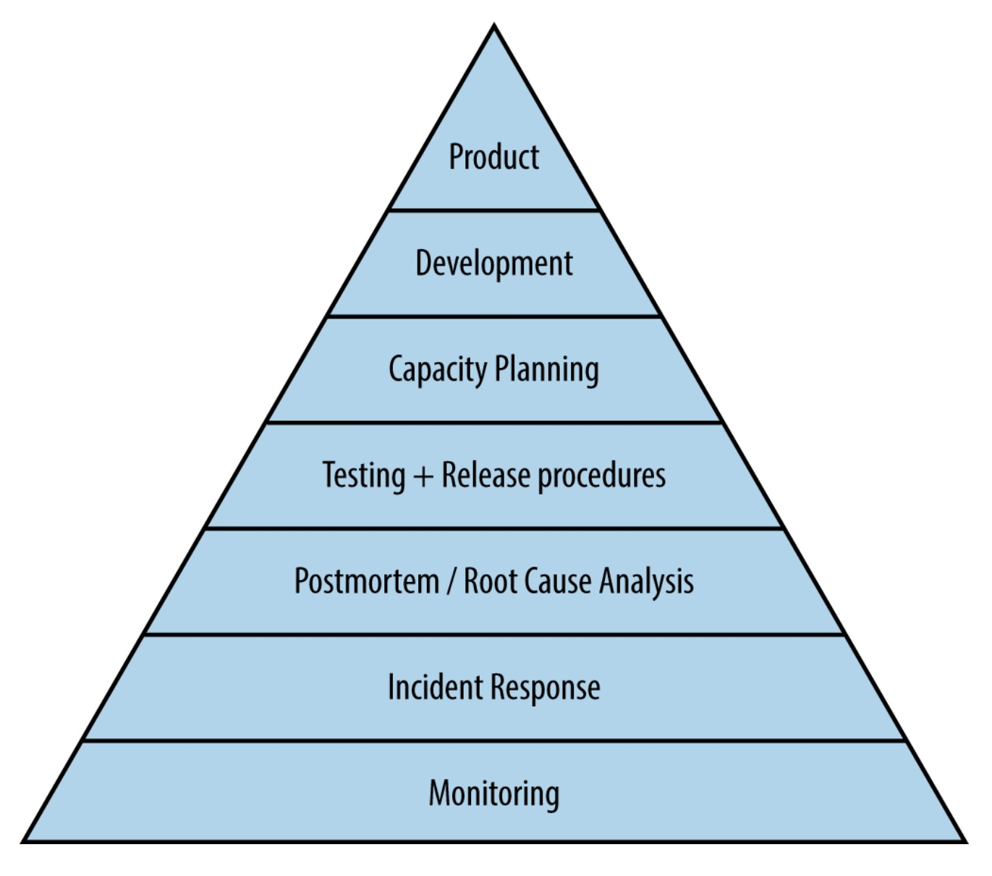

What is Site Reliability Engineering (SRE) ?
“Fundamentally, it’s what happens when you ask a software engineer to design an operations function.”
Ops to scale with load through Automation
50% time spend on toil - 50% on engineering projects (improvements)
Error budget
Actionable alerts
4 Golden Signals: Latency, Traffic, Errors, Saturation
Change management:
Progressive rollouts
Problem detection
Change rollbacks
Capacity Planning
SRE is a highly automated service management approach, designed for supporting products & services running at global scale in a homogeneous cloud environment
SRE Notable Features
Site
Reliability
Engineering
(SRE)
SRE Principles
SRE Practices
Embracing Risk
Service Level Objectives
Eliminating Toil
Monitoring
Automation
Release Engineering
Simplicity
Notes:
Source for triangle on the lower right: Site Reliability Engineering, O‘Reilly Media, Inc

Slide 19
Operations Transformation – Bridging from Traditional IT Management to Cloud
1 - Re-invent ITIL for cloud native
2 - Modernize ITIL for cloud enabled
3 - Integrate across to enable a seamless experience that results in confidence
Traditional Operations
Process Driven (e,g ITIL)
DevOps Tool Chain
Service Transition
Change
Release Service Operations
Monitoring / Event
Incident
Problem
Service Request
Security and Compliance
Service Strategy
Service Design
Service Improvement
For Example
Build monitoring scripts
Deploy scripts
Monitor
Still need to accomplish the same goals – but the method is different.
Embedded and automated
Shared Responsibility
What used to be done purely in Operations, is now accomplished across the DevOps lifecycle
Information needs to be integrated across both old and new

Slide 20
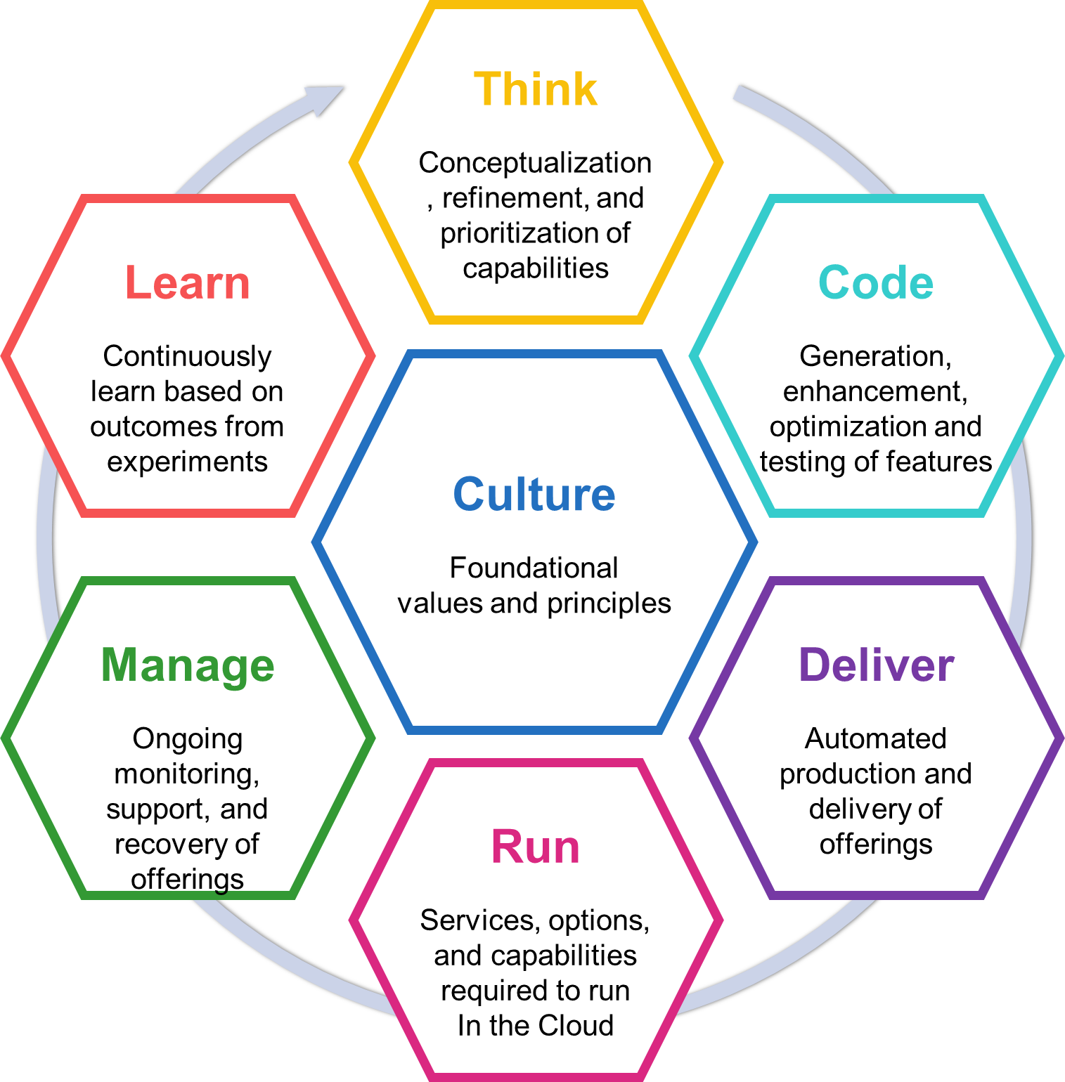
Cloud Service Management and Operations offering in the Bluemix Garage
The Bluemix Garage methodology drives transformational change using design thinking.
Deliver Operations for New Bluemix Development Culture
Harden Applications for Production Availability
Increase Service Management Efficiency
The CSMO Offering addresses the specific needs of the Operational side, just like the Bluemix Garage does for the Development side. Plus, we will enable cross-fertilization and integration between these offerings.
Visit : Overview, live showcases, dialog and success stories
Workshop : Uses design thinking to define personas, needs and transformational needs
MVP : Assist and partner to develop a working solution that begins the transformation
Transformation : Provide leadership and guidance in extending the MVP in transforming operational capabilities and processes
Half day
2-5 days
4-12 weeks
12+ weeks

Slide 21
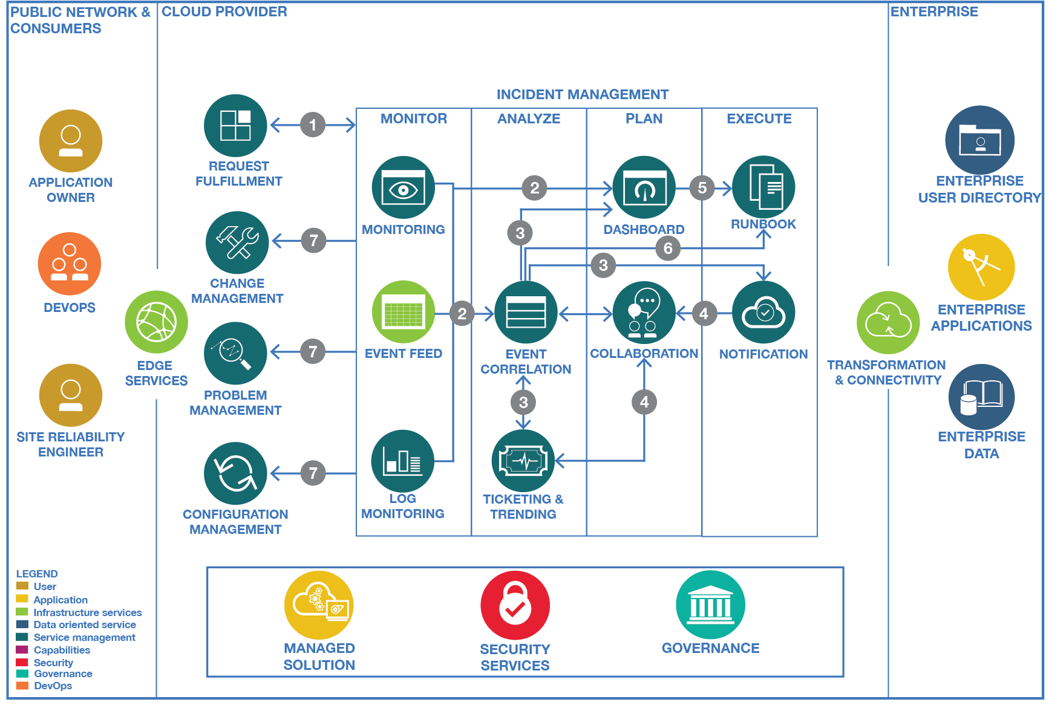
Incident Management
Assure Availability and Performance of applications running on the IBM Cloud platform, given the target SLA of 99.99% availability for applications
Reduce mean-time-to-repair to restore service as quickly as possible
Managing and controlling operational risks and threats
Notes:
Sense, isolate, diagnose

Slide 22
Incident Management

Slide 23


Incident Management Tool Chain
Dashboards & Reporting
Runbooks
Monitoring
Event
Management
Logging
Notification
Collaboration
Ticketing & Trending
Monitor
Analyze
Plan
Execute

Slide 24
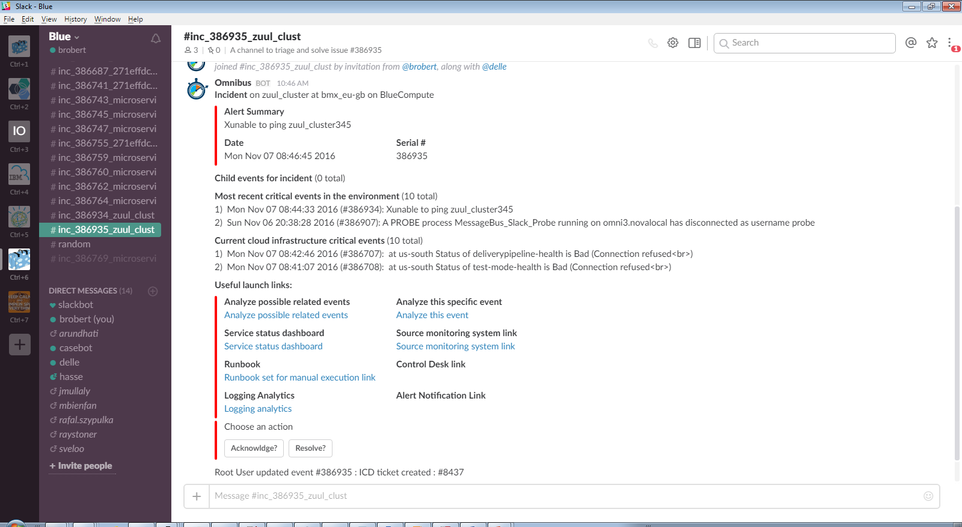
Incident Management ChatOps Rapid restoration of service through collaboration
Instant Collaboration
between SMEs …
Various Operations roles
Developers
Vendor / Provider
… and between Humans and Applications (through BOTs)
noi pull - retrieve the event from NOI noi ack - acknowledge the event noi deack – de-acknowledge the event noi ticket - open an ICD ticket for the event noi ans send - open an ANS alarm for the event noi journal - add a journal entry to the event noi resolve - resolve event (set severity to 0) noi critical - re-raise event (set severity to 5) noi sev # - set the severity of the event to # noi rba - retrieve the Runbook associated with the event noi list - show the latest events in the ObjectServer

Slide 25
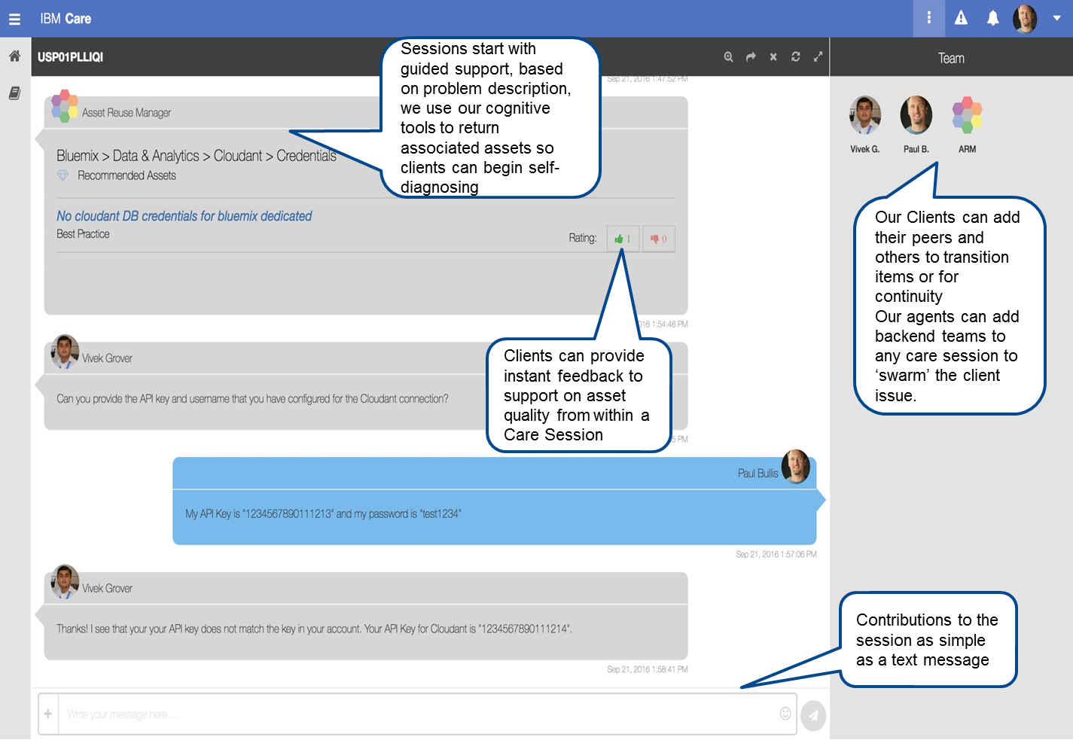
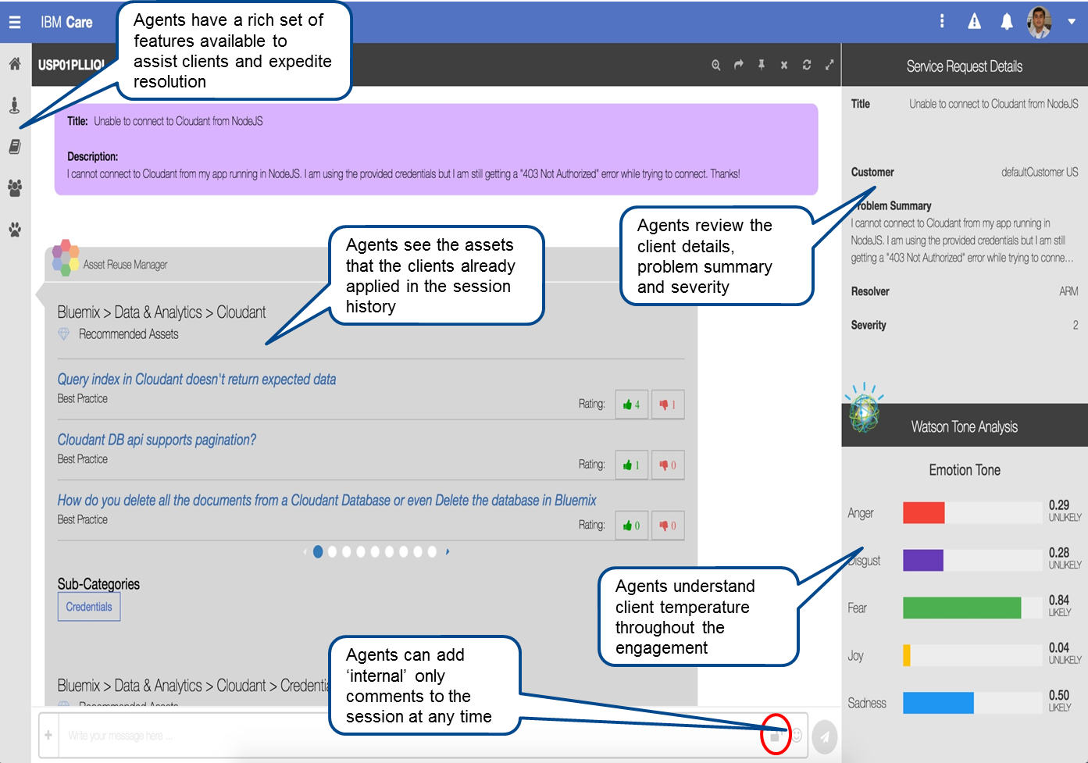
Incident Management Collaboration with IBM Support through IBM Care
Integrating IBM Cloud Support for an seamless Client Experience
Simplified communication; chat-like “Care sessions”
Client View
IBM Support View

Slide 26
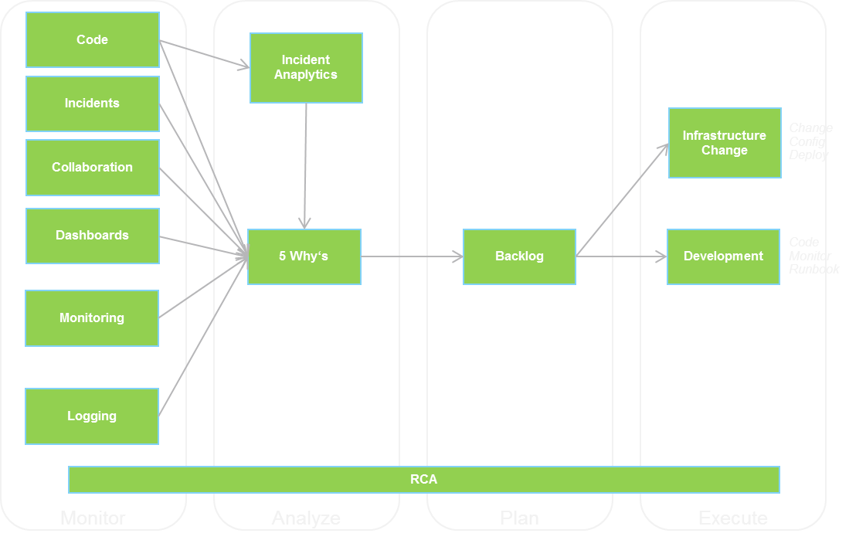
Problem Management
Identify and resolve the root cause of service disruptions
Prevent Incidents from happening again.
Find trends in incidents, group those incidents into problems, identify the root causes of problems, and initiate change requests against those problems.
Continued Service Improvement
Notes:
Call Home; First Failure Data Capture

Slide 27
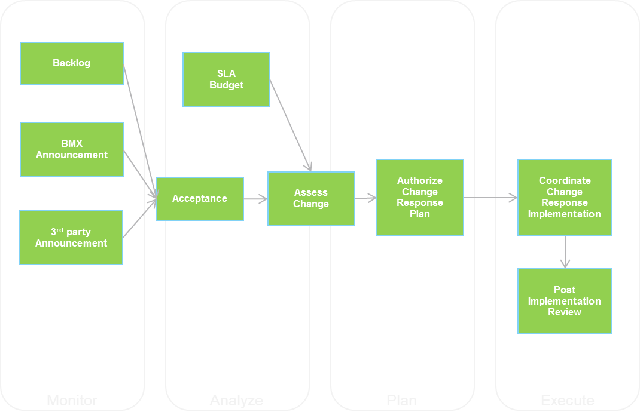
Change Management
The purpose of the Change Management process is to achieve the successful introduction of changes to an IT system or environment. Success is measured as a balance of the timeliness and completeness of change implementation, the cost of implementation, and the minimization of disruption caused in the target system or environment.
Automation is used to
Implement progressive rollouts
Quickly and acurately detect change-related problems („deployment marker“)
Roll back changes safely when problems arise
Scheduling of Changes affected by current „Error Budget“
Notes:
One of the ways Google helps manage the drive of the dev team to release often and Ops drive to improve reliability is through Error Budgets. By clearly establishing SLAs and measuring the problems against the service SRE can turn an opinion into a math problem. As long as the dev team is in the black (not exceeding their error budget) then they can launch away.
The DevOps team can “spend” this error budget in any way they like. If the product is currently running flawlessly, with few or no errors, they can launch whatever they want, whenever they want. Conversely, if they have met or exceeded the error budget and are operating at or below the defined SLA, all launches are frozen until they reduce the number of errors to a level that allows the launch to proceed.

Slide 28
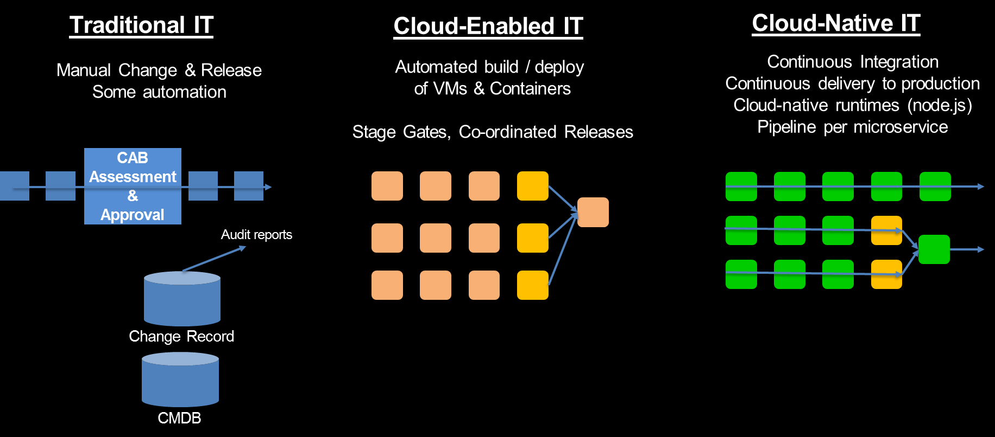
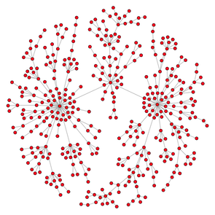
Change Management – Processes Change
Topology / Relationship Graph

Slide 29
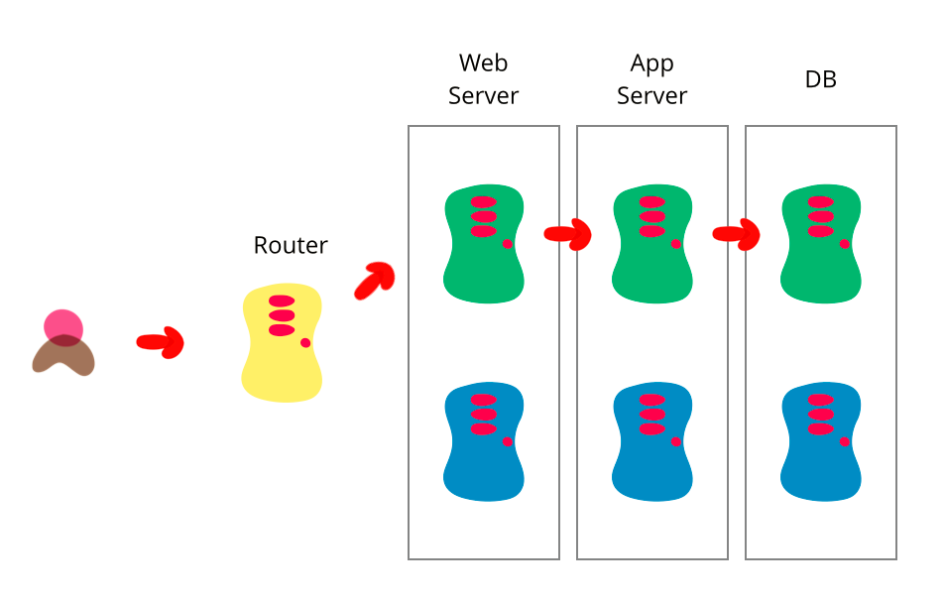
Change Management – Blue-Green Deployment
Blue-green deployment also gives you a rapid way to rollback - if anything goes wrong you switch the router back to your blue environment.
Note on databases: Separate the deployment of schema changes from application upgrades. So first apply a database refactoring to change the schema to support both the new and old version of the application, deploy that, check everything is working fine so you have a rollback point, then deploy the new version of the application.
Source: https://martinfowler.com/bliki/BlueGreenDeployment.html
Notes:
One of the challenges with automating deployment is the cut-over itself, taking software from the final stage of testing to live production. You usually need to do this quickly in order to minimize downtime. The blue-green deployment approach does this by ensuring you have two production environments, as identical as possible. At any time one of them, let's say blue for the example, is live. As you prepare a new release of your software you do your final stage of testing in the green environment. Once the software is working in the green environment, you switch the router (load-balancer) so that gradually incoming requests go to the green environment until the blue one is idle.

Slide 30
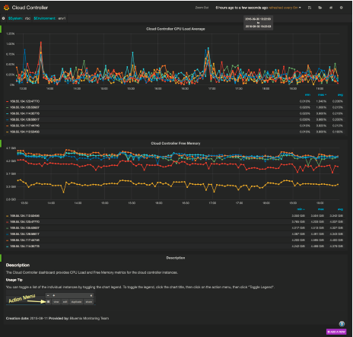
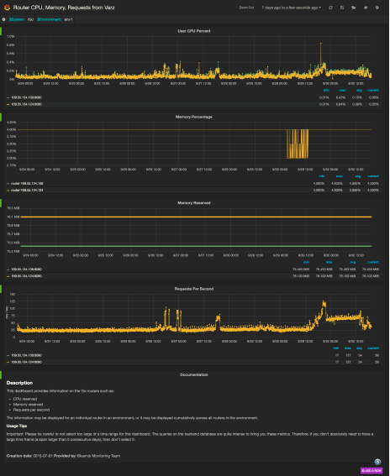
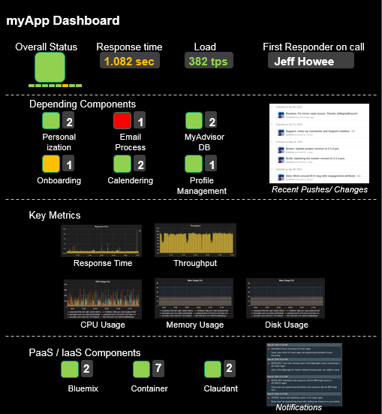
Dashboarding & Reporting
Dashboards provide a summary view of an applications core metric and key performance indicators (KPI). They also show relevant information on Platform Health. Reports harden the information of broader consumption.
Dashboards don’t replace dedicated UIs, but rather federate information from multiple places into a single console.
Dashboards are application-specific and persona-driven (not a one size fits all), information shown should be actionable.
SRE teams are typically event driven and avoid the situation that requires someone to stare at a screen watching for problems. Still, SRE teams use a number of dashboards to visualize the health and status of their Cloud environments.
Typical Uses for dashboards
Event Aggregation / Correlation
Analyzing Long-Term Trends
Comparing over time or experiment groups
Collecting ad-hoc retrospective analysis
Mash-up of disparate sources to find correlations
Visualizing recent changes
4 Golden Signals: Latency, Traffic, Errors, Saturation
Deployment Markers
Continued Improvement through feedback
Notes:
Guiding principle what to show / expose: Is it actionable. Does it support the persona in deciding & taking the best next action.
Mash-up of disparate sources of information to find correlations (i.e. show me #users / vs performance or Changes and performance peaks over the same time period)

Slide 31
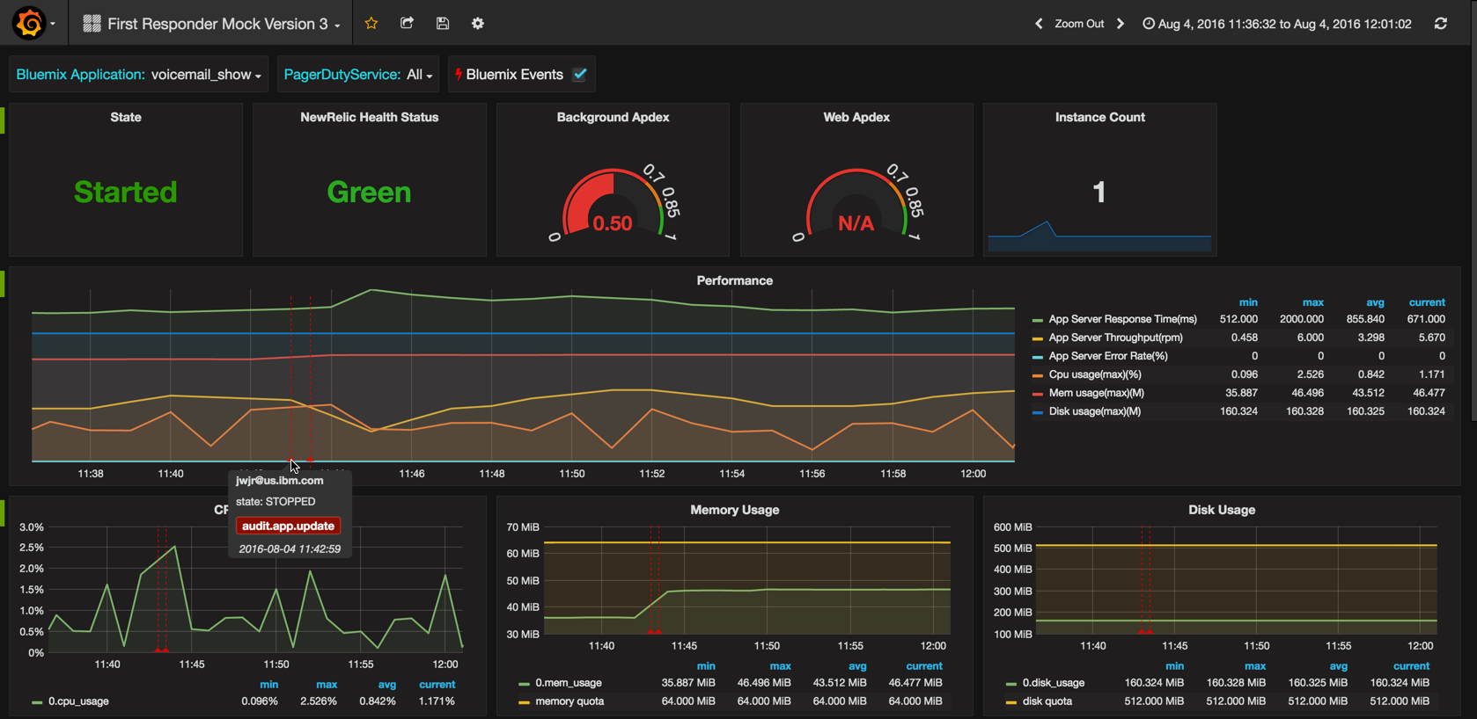
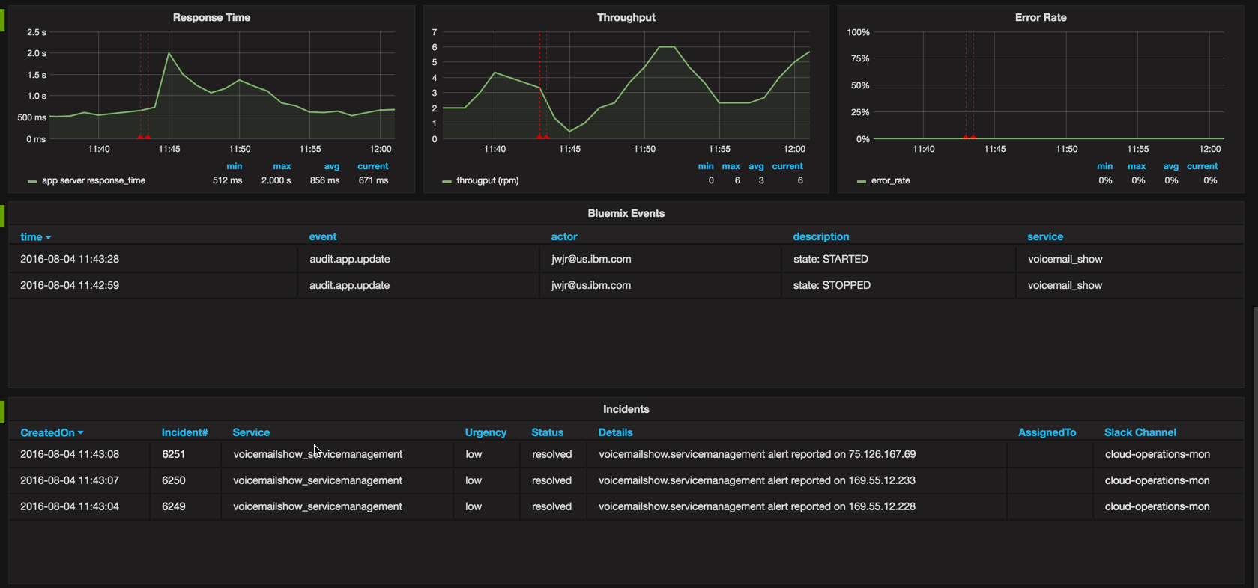
Dashboarding & Reporting – First Responder
Notes:
Guiding principle what to show / expose: Is it actionable. Does it support the persona in deciding & taking the best next action.

Slide 32
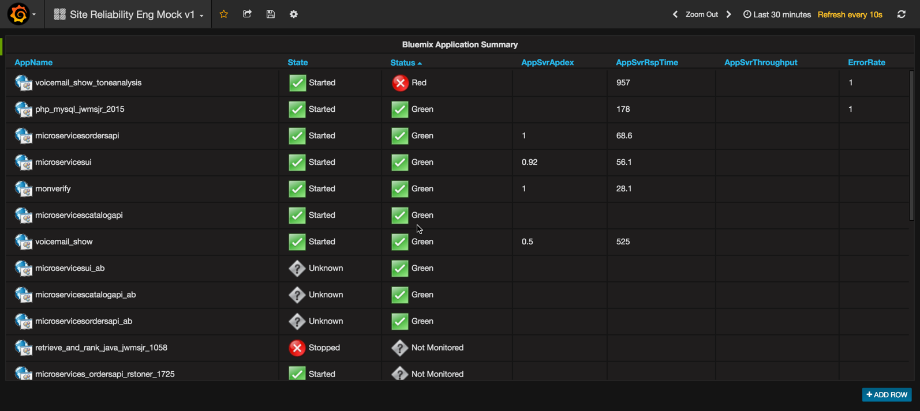
Dashboarding & Reporting – SRE
Notes:
Guiding principle what to show / expose: Is it actionable. Does it support the persona in deciding & taking the best next action.

Slide 33
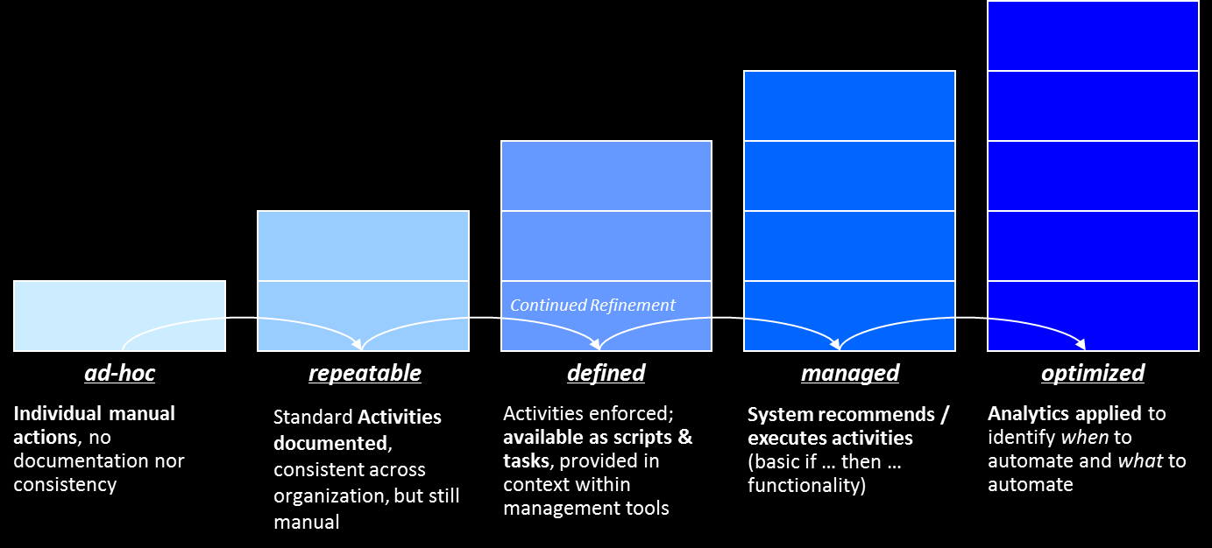
Operations
Operations describes the activities performed to deliver the right set of services at the right quality and at competitive costs for customers. IT Operations Management executes day-to-day routine tasks related to the operation of infrastructure components and applications, for instance
Application / Systems Availability and Health Checks
Compliance Checks
Monitoring of Performance and Capacity
Backups
In cloud environments, manual work related to these activities should be minimal in favor of long-term engineering project work. „If a human operator needs to touch your system during normal operations, you have a bug.“ (*).
Elimination of manual tasks and automation of repetitive tasks are vital.
Transition to Self-Service further reduces the need for Operations
Automation
... to resolve a problem
... to support problem determination
... to remove manual work
* Site Reliability Engineering, B.Beyer et al.; O‘Reilly
Notes:
The following activities detail typical operations activities that should be elimiated or automated
Manual
Repetitive
Automateable
Tactical (interrupt-driven)
No enduring value
Work that scales linear with service growth

Slide 34
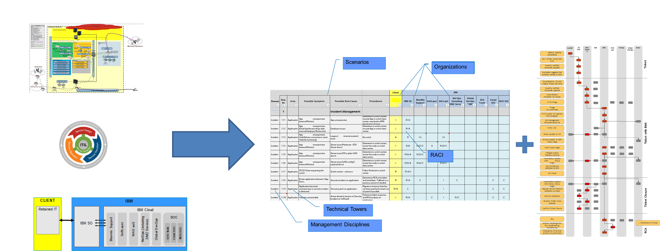
Operations – Operational RACI
R - responsible
A - accountable
C - consulted
I - informed
Offering to develop a responsibility assignment matrix for the Operational aspects of a solution: RACI matrix and Process Swimlanes for key scenarios for a given solution / organization.
Notes:
The following activities detail typical operations activities that should be elimiated or automated
Manual
Repetitive
Automateable
Tactical (interrupt-driven)
No enduring value
Work that scales linear with service growth

Slide 35

Compliance Management
Compliance Management (as part of (Governance, Risk Management, and Compliance – GRC) is targeted to address these concerns:
Ensuring compliance with evolving and increasingly complex regulations
Managing through regulatory change / avoiding fines
Coordinating compliance across multiple diverse jurisdictions
Building efficient operations
Compliance is defined by laws & regulations (i.e. HIPPA, EU Data Protection), Certifications (i.e. FIPS), and Frameworks (i.e. FISMA, PCI). To meet more stringent compliance requirements, there may be specific client-specific requirements on top.
Implementing Compliance Management
Defining and Implementing Compliance Controls
Steady monitoring / assessment of conformity, alerting if there is a violation of a control object
Assessment and Response - ideally automatic – to these violations. This could range from runbook automation to strategies like active deployment (Blue/Green) to assure that the services and SLAs are not disrupted.
Reporting and Documentation of Compliance information
Validating by internal and/or external auditors via process walkthroughs and evidence evaluation.
Link to Security spine
Icon by DesignContest, http://www.designcontest.com

Slide 36
Build To Manage – How to build manageable applications
As Development and Operations come closer together, new practices arise to better enable operations for cloud-based applications.
Shift Left: Build manageable applications / micro-services
Practices Include
HealthCheck API
Deployment Correlation
Topology Information
Test Cases and Scripts
Runbooks
manageability
management
Health API
Log Format and Catalog
Distributed Tracing
Event Format and Catalog
Monitoring Configuration
First Failure Data Capture
Runbook
Events
Logs
Application / Micro Service
(Managed entity)
Manageability defines how managed entities communicate with management functions
Management Tool
Management System
Application-specific Management Instrumentation
Component of the Management Stack

Slide 37

Build To Manage - The Twelve-Factor App
Popular platform-as-a-service provider Heroku maintains a manifesto of sorts called The Twelve-Factor App. It outlines a methodology for developers to follow when building modern web-based applications and can be seen as the best practices for creating microservices. The twelve-factor app is a methodology for building software-as-a-service apps that:
Use declarative formats for setup automation, to minimize time and cost for new developers joining the project;
Have a clean contract with the underlying operating system, offering maximum portability between execution environments;
Are suitable for deployment on modern cloud platforms, obviating the need for servers and systems administration;
Minimize divergence between development and production, enabling continuous deployment for maximum agility;
And can scale up without significant changes to tooling, architecture, or development practices.
The twelve-factor methodology can be applied to apps written in any programming language, and which use any combination of backing services (database, queue, memory cache, etc).
Codebase - One codebase tracked in revision control, many deploys
Dependencies - Explicitly declare and isolate dependencies
Config - Store config in the environment
Backing services - Treat backing services as attached resources
Build, release, run - Strictly separate build and run stages
Processes - Execute the app as one or more stateless processes
Port binding - Export services via port binding
Concurrency - Scale out via the process model
Disposability - Maximize robustness with fast startup and graceful shutdown
Dev/prod parity - Keep development, staging, and production as similar as possible
Logs - Treat logs as event streams
Admin processes - Run admin/management tasks as one-off processes

Slide 38
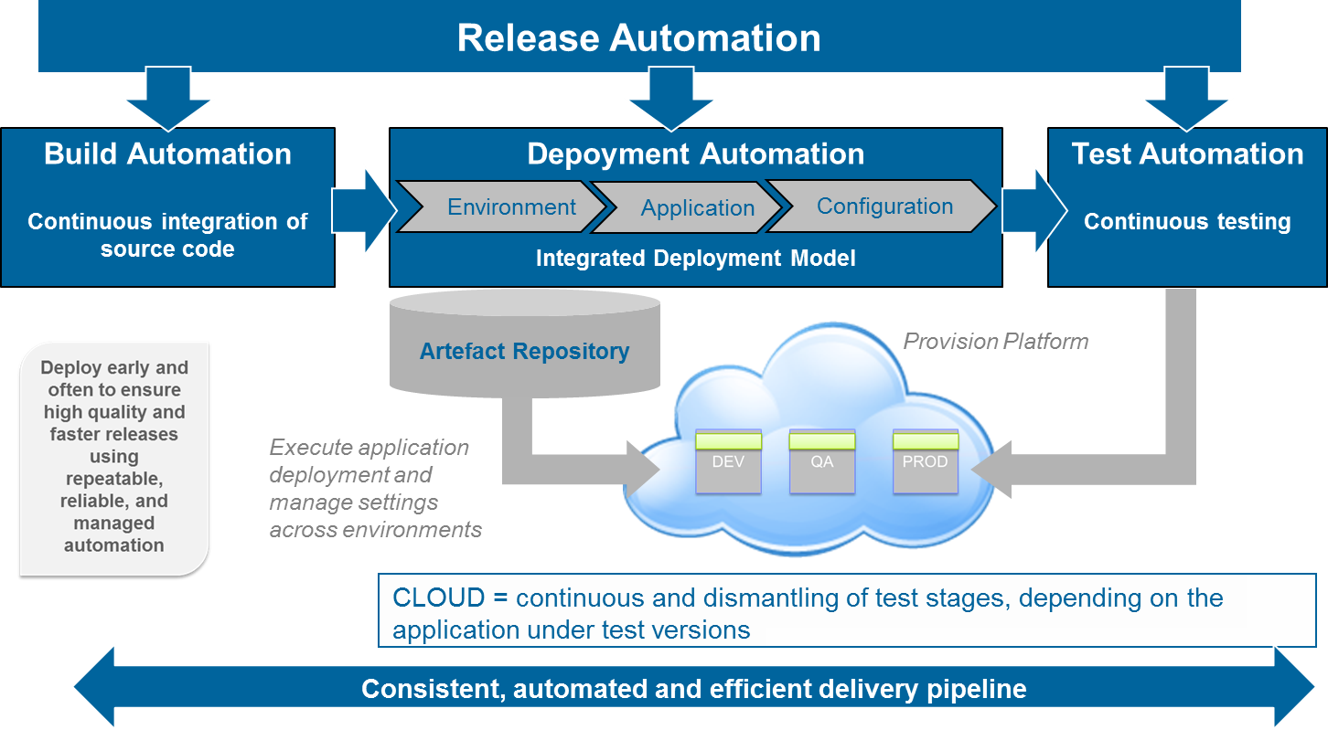
Release Management
DevOps characteristics
Deploy frequently using repeatable and reliable processes, fail early
Automate, Version, Test everything (including Infrastructure)
Continuously validate operational quality characteristics
Link to DevOps spine
Icon by DesignContest, http://www.designcontest.com
Notes:
Icon Source:
Artist: DesignContest (Available for custom work) Iconset: Ecommerce Business Icons (83 icons) License: CC Attribution 4.0 Commercial usage: Allowed (Backlink to http://www.designcontest.com required)

Slide 39
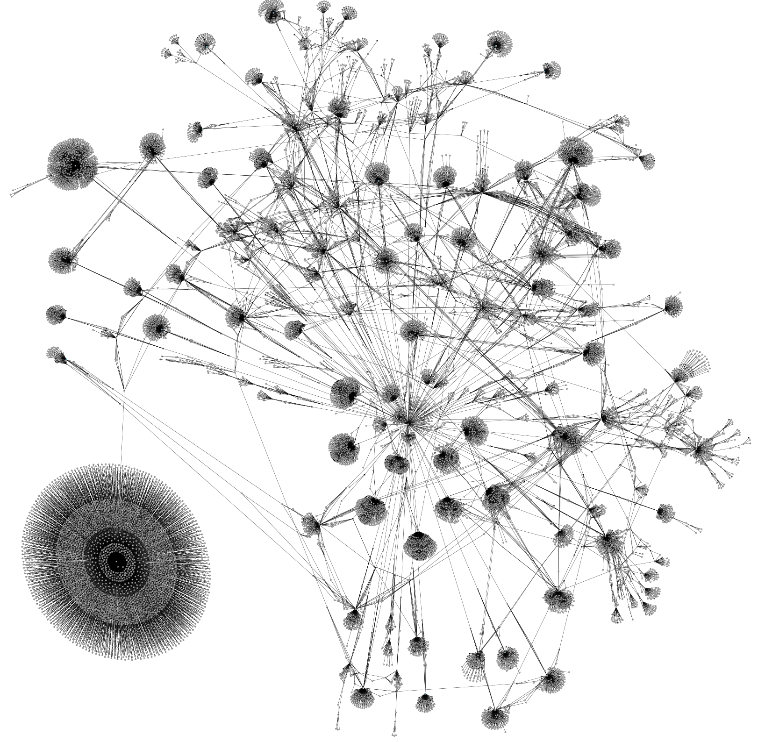
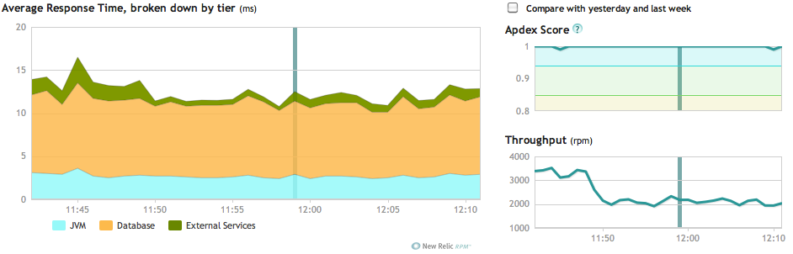
Configuration Management
Configuration Management identifies, controls, and maintains all elements in the IT infrastructure called Configuration Items.
The purpose of the Configuration Management process is to maintain the integrity of the configuration item (CI) employed in, or related to, IT systems and infrastructure, and to provide accurate information about CIs and their relationships.
The role of Configuration Management Systems (CMS, CMDB) shifts towards holding meta data such information on SLA, Client, Business Relationships, Topology, etc.. Technical information is dynamically pulled directly from the platform at the time it is needed. New Technologies such as Graph Databases allow scale and rapid model extensions.
Continuous Integration and Continuous Deployment methodologies enable a rapid flow of features into the production. It becomes increasingly important for operation teams to be able to easily and effectively correlate performance and stability issues with application and configuration changes that has been made. Deployment Markers can send notification triggers to management systems, enabling them to track when an issue was introduced due to a change.

Slide 40
Service Continuity
Service Continuity encompasses IT disaster recovery planning and wider IT resilience planning.
It spans the entire Infrastructure (i.e. Availability Zones) and Application Architecture (i.e. dealting with stale data)
Service Continuity contains the following aspects:
High Availability
Disaster Recovery
Backup / Restore
Archiving
Link to Resiliency spine
Icon by DesignContest, http://www.designcontest.com
Notes:
Icon Source:
Artist: DesignContest (Available for custom work) Iconset: Ecommerce Business Icons (83 icons) License: CC Attribution 4.0 Commercial usage: Allowed (Backlink to http://www.designcontest.com required)

Slide 41
Performance and Capacity Management
The primary goal of Capacity management is to ensure that IT resources are right-sized to meet current and future business requirements in a cost-effective manner.
It includes monitoring of performance and throughput metric. In a cloud environment, the traditional metrics such as CPU, Memory, Disk are less relevant than other parameters: the 4 Golden Signals: Latency, Traffic, Errors, Saturation
Performance analysis of measurement data, including analysis of the impact of new releases on capacity.
Performance tuning of activities to ensure the most efficient use of existing infrastructure
Link to Performance spine
Icon by DesignContest, http://www.designcontest.com
Notes:
Icon Source:
Artist: DesignContest (Available for custom work) Iconset: Ecommerce Business Icons (83 icons) License: CC Attribution 4.0 Commercial usage: Allowed (Backlink to http://www.designcontest.com required)

Slide 42
Service Level Management
BPaaS
Business Unit
A service-level agreement (SLA) is defined as an official commitment between a service provider and the consumer. Particular aspects of the service – quality, availability, reliability, responsibilities – are agreed between the service provider and the service user.
A service level objective (SLO) is a key element of a an SLA. SLOs are agreed as a means of measuring the performance of the service provider and are outlined as a way of avoiding disputes between the two parties based on misunderstanding.
Error Budgets (maximum allowable threshold for errors and outages) help to trade off reliability against other goals such as introducing new functionality. Error budget is a measure of risk, it is the amount of headroom you have above your SLA.
SLA information should be presented in the Dashboards to help prioritization of work.
Create a culture of accountability across all levels of the IT organization
Service Integration becomes the default as applications will be based on internal services as well as external services across multiple providers. Supplier Management manages the interactions with third party organizations
Vertical x
SaaS
App1
App2
App n
PaaS
IaaS
Application
Service Integration
Internal Services
Provider 1
...
Provider n
Notes:
SLOs must be:
Attainable
Repeatable
Measurable
Understandable
Meaningful
Controllable
Affordable
Mutually acceptable

Slide 43
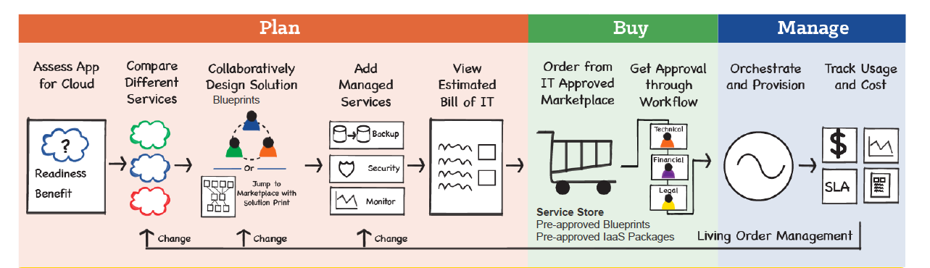
Financial Management
The aim of Financial Management is to give accurate and cost effective stewardship of IT assets and resources used in providing IT Services. It is used to plan, control and recover costs expended in providing the IT Services negotiated and agreed to in a service-level agreement (SLA).
Specific to Cloud, a key actvity is to aggregate, compare, estimate, provision, and manage cloud services and associated costs across multiple providers. Value proposition:
Reduce shadow IT – flexibility of choice for end users within the organization’s compliance framework.
Rapid financial decision making for the CIO by consolidating all cloud service costs on a single dashboard.
Negotiate better T&C’s with Cloud providers based on performance visibility.
Enforce organizational policy compliance for service selection – based on cost, location, workload or performance requirements.
Integrated service management across traditional and cloud IT services – enabling the virtual data center.
Understand Development and Operations Costs, enable appropriate Billing

Slide 44



Business Performance
Business-oriented operational insight - Alignment of Business Performance with Service Management and Operations is critical to …
Understand the impact of business needs on IT services and infrastructure
Link key business service components and capabilities to the goals of the business
Align response of IT staff and service providers to priorities of the business
Especially for agile applications in the Cloud, direct feedback of end users is desired. Practices such as A/B testing is applied to compare between releases.
Effectiveness of recent functionality / code change
Customer sentiment analysis
Business Performance data will be used for instance
In dashboards to append application data with business data
In incident Management (Monitoring, Correlation, Prioritization) to prioritize activities according to business impact
In backlog prioritization to decide what to do next
IBM has developed Process Maps and KPIs available for more than 30 industries.
Proactively communicate value
Build stakeholder trust
Track operational health
Notes:
IBM Process Maps and KPIs available for these industries
Aerospace
Airlines
Automotive
Banking Retail
Banking Wholesale
Consumer Products
Electronics Consumer
Electronics Cont Mfg
Electronics Semiconductor
Energy & Utilities
Energy Utilities
Financial Markets Buy
Financial Markets Sell
Freight and Logistics
Healthcare
Industrial Chemical
Industrial Forest and Paper Products
Industrial Other Process
Industrial Petroleum Downstream
Industrial Petroleum Upstream
Industrial SMB
Industrial Textiles
Insurance Life
Insurance Property and Casualty
Life Sciences
Media Entertainment
Retail General Merchandise
Retail Grocery
Telecommunications Business Process Maps
Wholesale Distribution Business Process Maps
http://kpilibrary.com/
KPI Library is an initiative of ServiceNow. KPI Library helps you to find the right performance indicators categorized by industry, by process and by business framework.
Browse KPIs by Industry
Accommodation & Food (130)
Agriculture & Forestry (46)
Banking & Insurance (98)
Biotechnology & Life Sciences (1)
Construction & Engineering (13)
Education & Research (149)
Emergency, Police & Justice (63)
Entertainment, Recreation & Arts (118)
Goods & Manufacturing (25)
Government & Public Works (142)
Healthcare & Social Assistance (194)
Media & Publishing (89)
Mining, Oil & Gas Extraction (11)
Miscellaneous (42)
Professional & Technical Services (35)
Real Estate, Rental & Leasing (82)
Technology (74)
Telecommunications (95)
Transportation & Warehousing (256)
Utilities (161)
Wholesale & Retail (101)

Slide 45
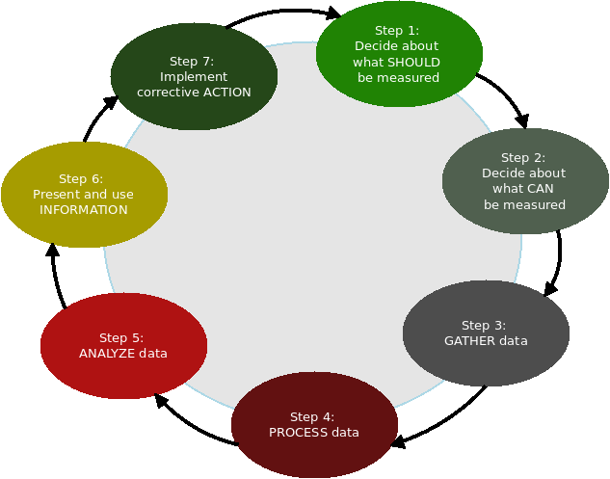
Continued Service Improvement
Continued Service Improvement (CSI) continually improves the effectiveness and efficiency of services and processes.
7 Steps towards CSI:
What should be measured?
What can be measured?
Gather data
Process the data
Analyse the data
Present and use the information
Implement corrective action
50% of the SRE time should be allocated to improvements (automation, improving reliability, performance and utilization)
Improvements driven from the end-user perspective: Perceived Availability and Performance, Sentiment Analysis, etc.
Analytics and Cognitive technology can assist in the analysis.
Event Analytics
Predictive Monitoring
Increasing Tier-1 Resolution with Cognitive Technology
Improvements to Incident / Problem / Change
Notes:
https://blog.zhaw.ch/icclab/how-to-apply-the-7-step-continual-service-improvement-process-in-a-cloud-computing-environment/

Slide 46

Tuesday, September 13, 2016
Cloud Service Management & Operations Offering (CSMO)

Slide 47
https://github.com/bluemix-enablement/ic171414

Slide 48
IBM Bluemix Garage CSMO Offering
Transform your thinking around Cloud Service Management and Operations (CSMO)
IBM Bluemix Garage’s CSMO offering helps enterprise clients adopt the right IT Operations practice for Cloud by identifying the organizational roles, processes, skills and tools necessary for optimal Service Management on Bluemix. Following the same “lean” approach emphasized in all Garage Offerings, Garage’s CSMO Offering brings your team guided assistance from our subject matter experts and helps transform the thinking around Service Management as a new Cloud-based tools chain and Operations model is created collaboratively. Garage’s CSMO Offering helps traditional IT Operations teams to improve efficiencies and developers to create applications that are “built-to-manage.”

Slide 49
IBM Bluemix Garage CSMO Offering
Definition | What is? IBM Bluemix Garage Method
Is a well-honed and well-integrated set of tracks and practices leveraging IBM Design Thinking, Lean Startup, Agile Development and DevOps with the power of Cloud. It is targeted at helping you to rapidly bring an innovation idea to life in the form of Minimum Viable Product or MVP – the smallest idea (app, API, technology, etc) that can be developed and tested to discover if it achieves the anticipated business outcome.

Slide 50
IBM Bluemix Garage CSMO Offering
Definition | What is? Built-to-Manage
Refers to the techniques and best practices used by application developers to provide operational information; for example, improved logging generating performance statistics, and providing service topology information.

Slide 51
IBM Bluemix Garage CSMO Offering
Offering At a Glance:
}
Garage CSMO Visit (duration: 4 hours)
CSMO Design Thinking Workshop (duration: 2 - 5 days)
CSMO MVP Build-Up Implementation of Selected MVP
Step 1
}
Step 2
}
Step 3
(duration: varies, “x” weeks)

Slide 52
Garage CSMO Visit

Slide 53
Garage CSMO Visit
CSMO Visit Goals:
Understand tools that enable an optimized operations process.
See firsthand how Cloud operations teams collaborate to quickly resolve issues.
Understand methods that developers can utilize to harden application code for the Bluemix environment.
Experience a tour of an operations team providing support for Bluemix-based applications.
Understand our practices to optimize availability for Bluemix-based applications.
Provide insight into building a Cloud-based tools chain.
Understand next steps to engage with us on your candidate project.
During your half day Garage CSMO Visit, hear IBM’s perspective on how Service Management will necessarily change in a hybrid-Cloud and DevOps world. Learn best practice and perspectives from our subject matter experts to help you navigate on your journey of cloud adoption.

Slide 54
CSMO Design Thinking Workshop

Slide 55
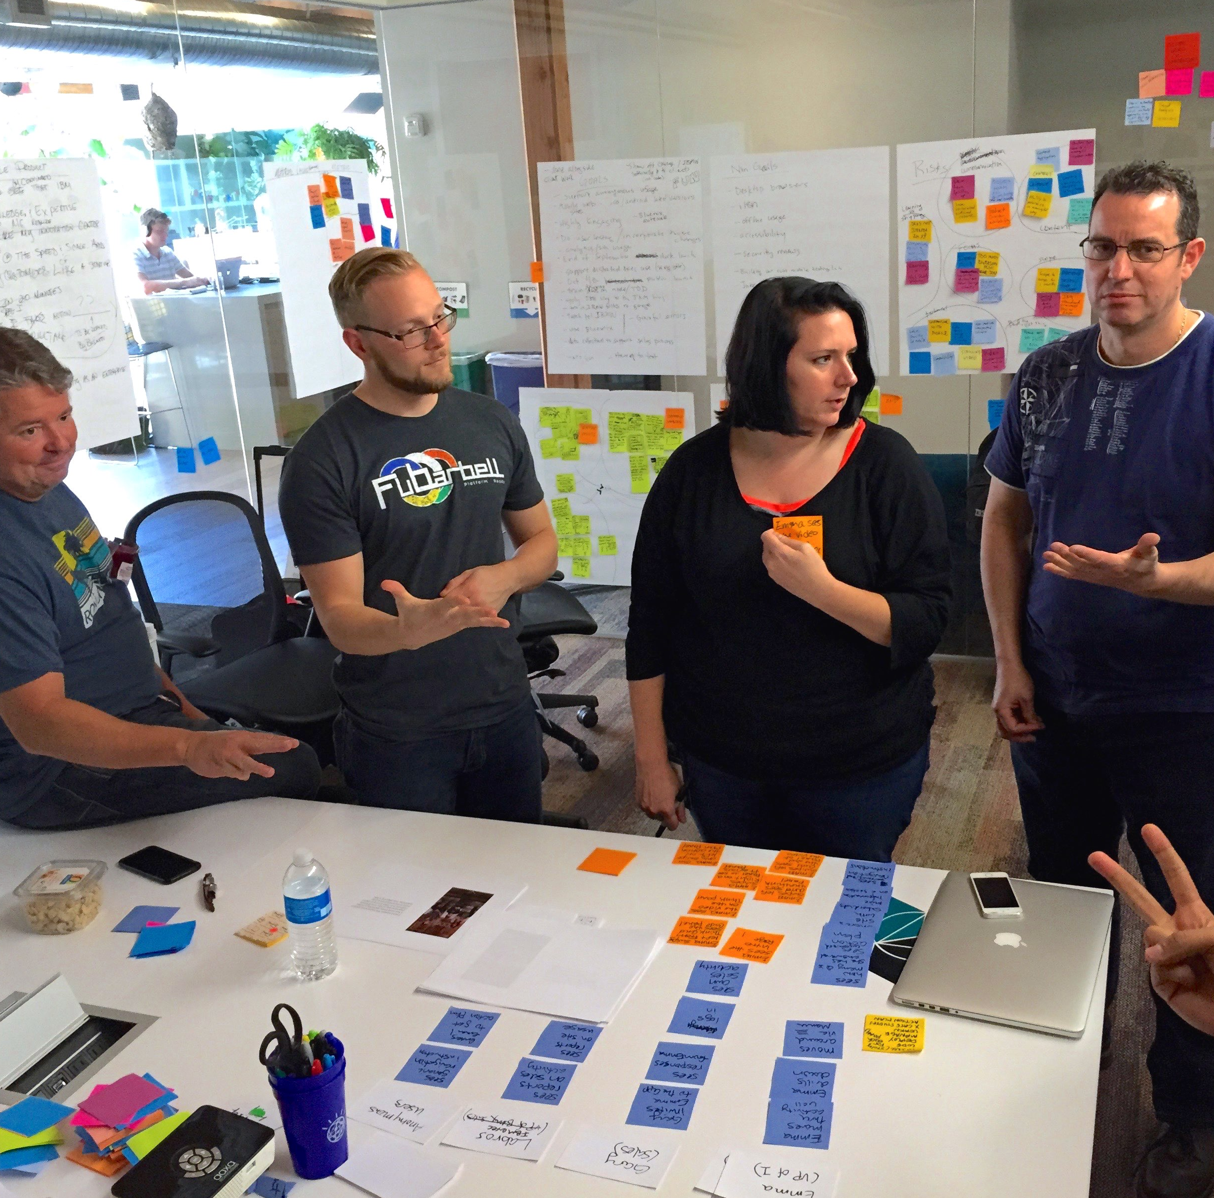
CSMO Design Thinking Workshop
Workshop Participants:
CLIENT TEAM (Suggested): Head of IT Operations (Manager)
Line of Business (Architect)
Methods and Tools (Architect)
Lead Developer (User)
Lead Ops Engineer (User)
L1 Administrator (End User) IBM BLUEMIX GARAGE TEAM: Design Thinking Facilitator(s) CSMO Practice SME(s)

Slide 56
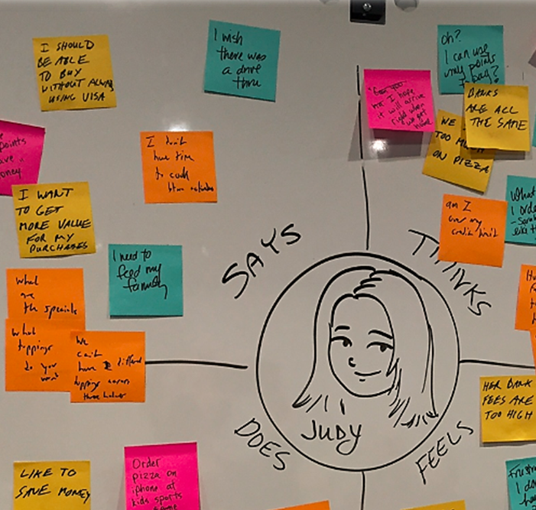
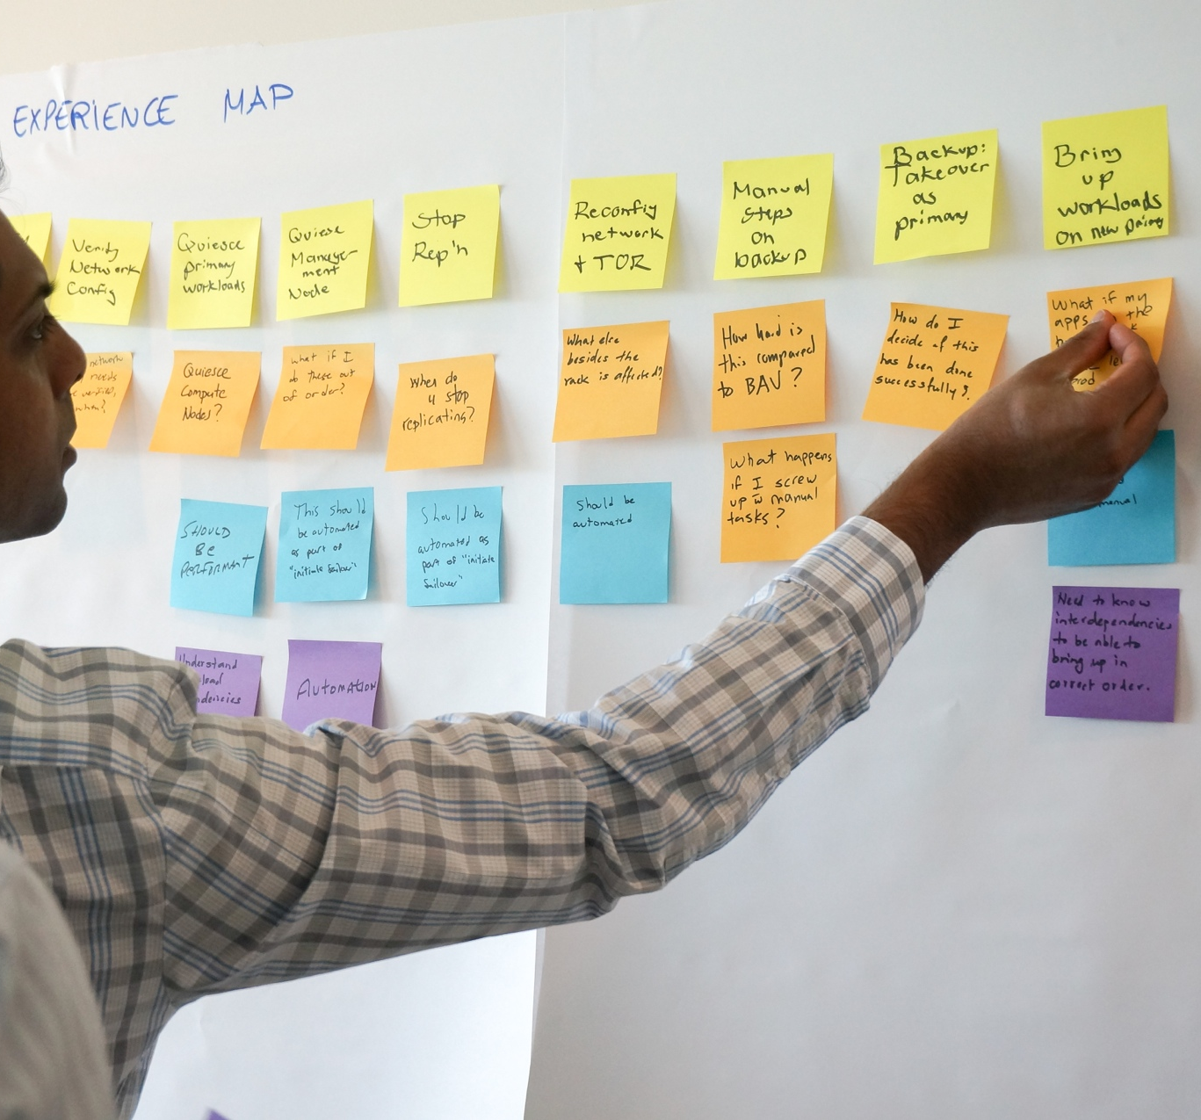
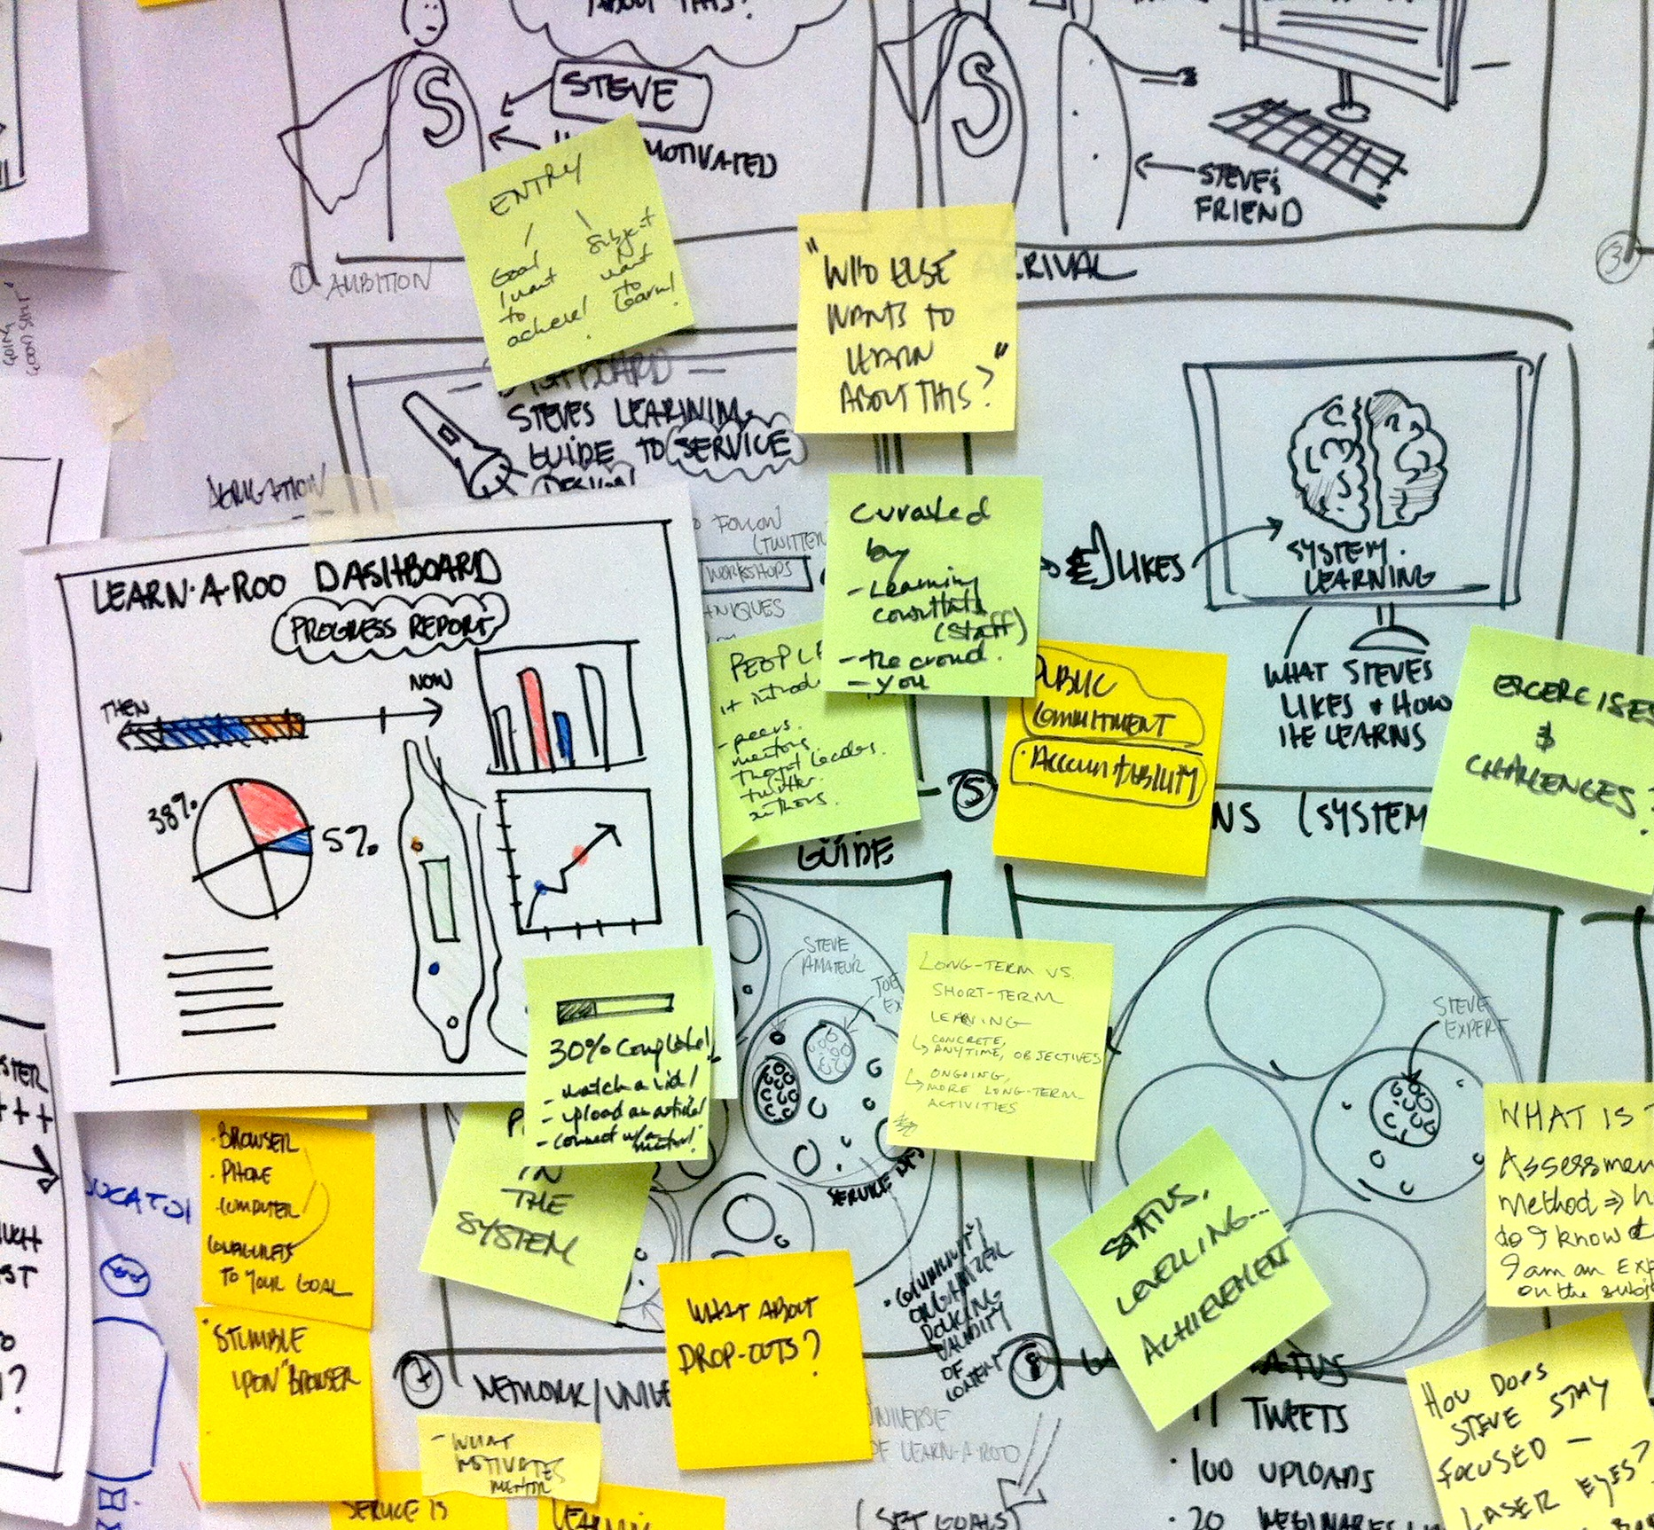
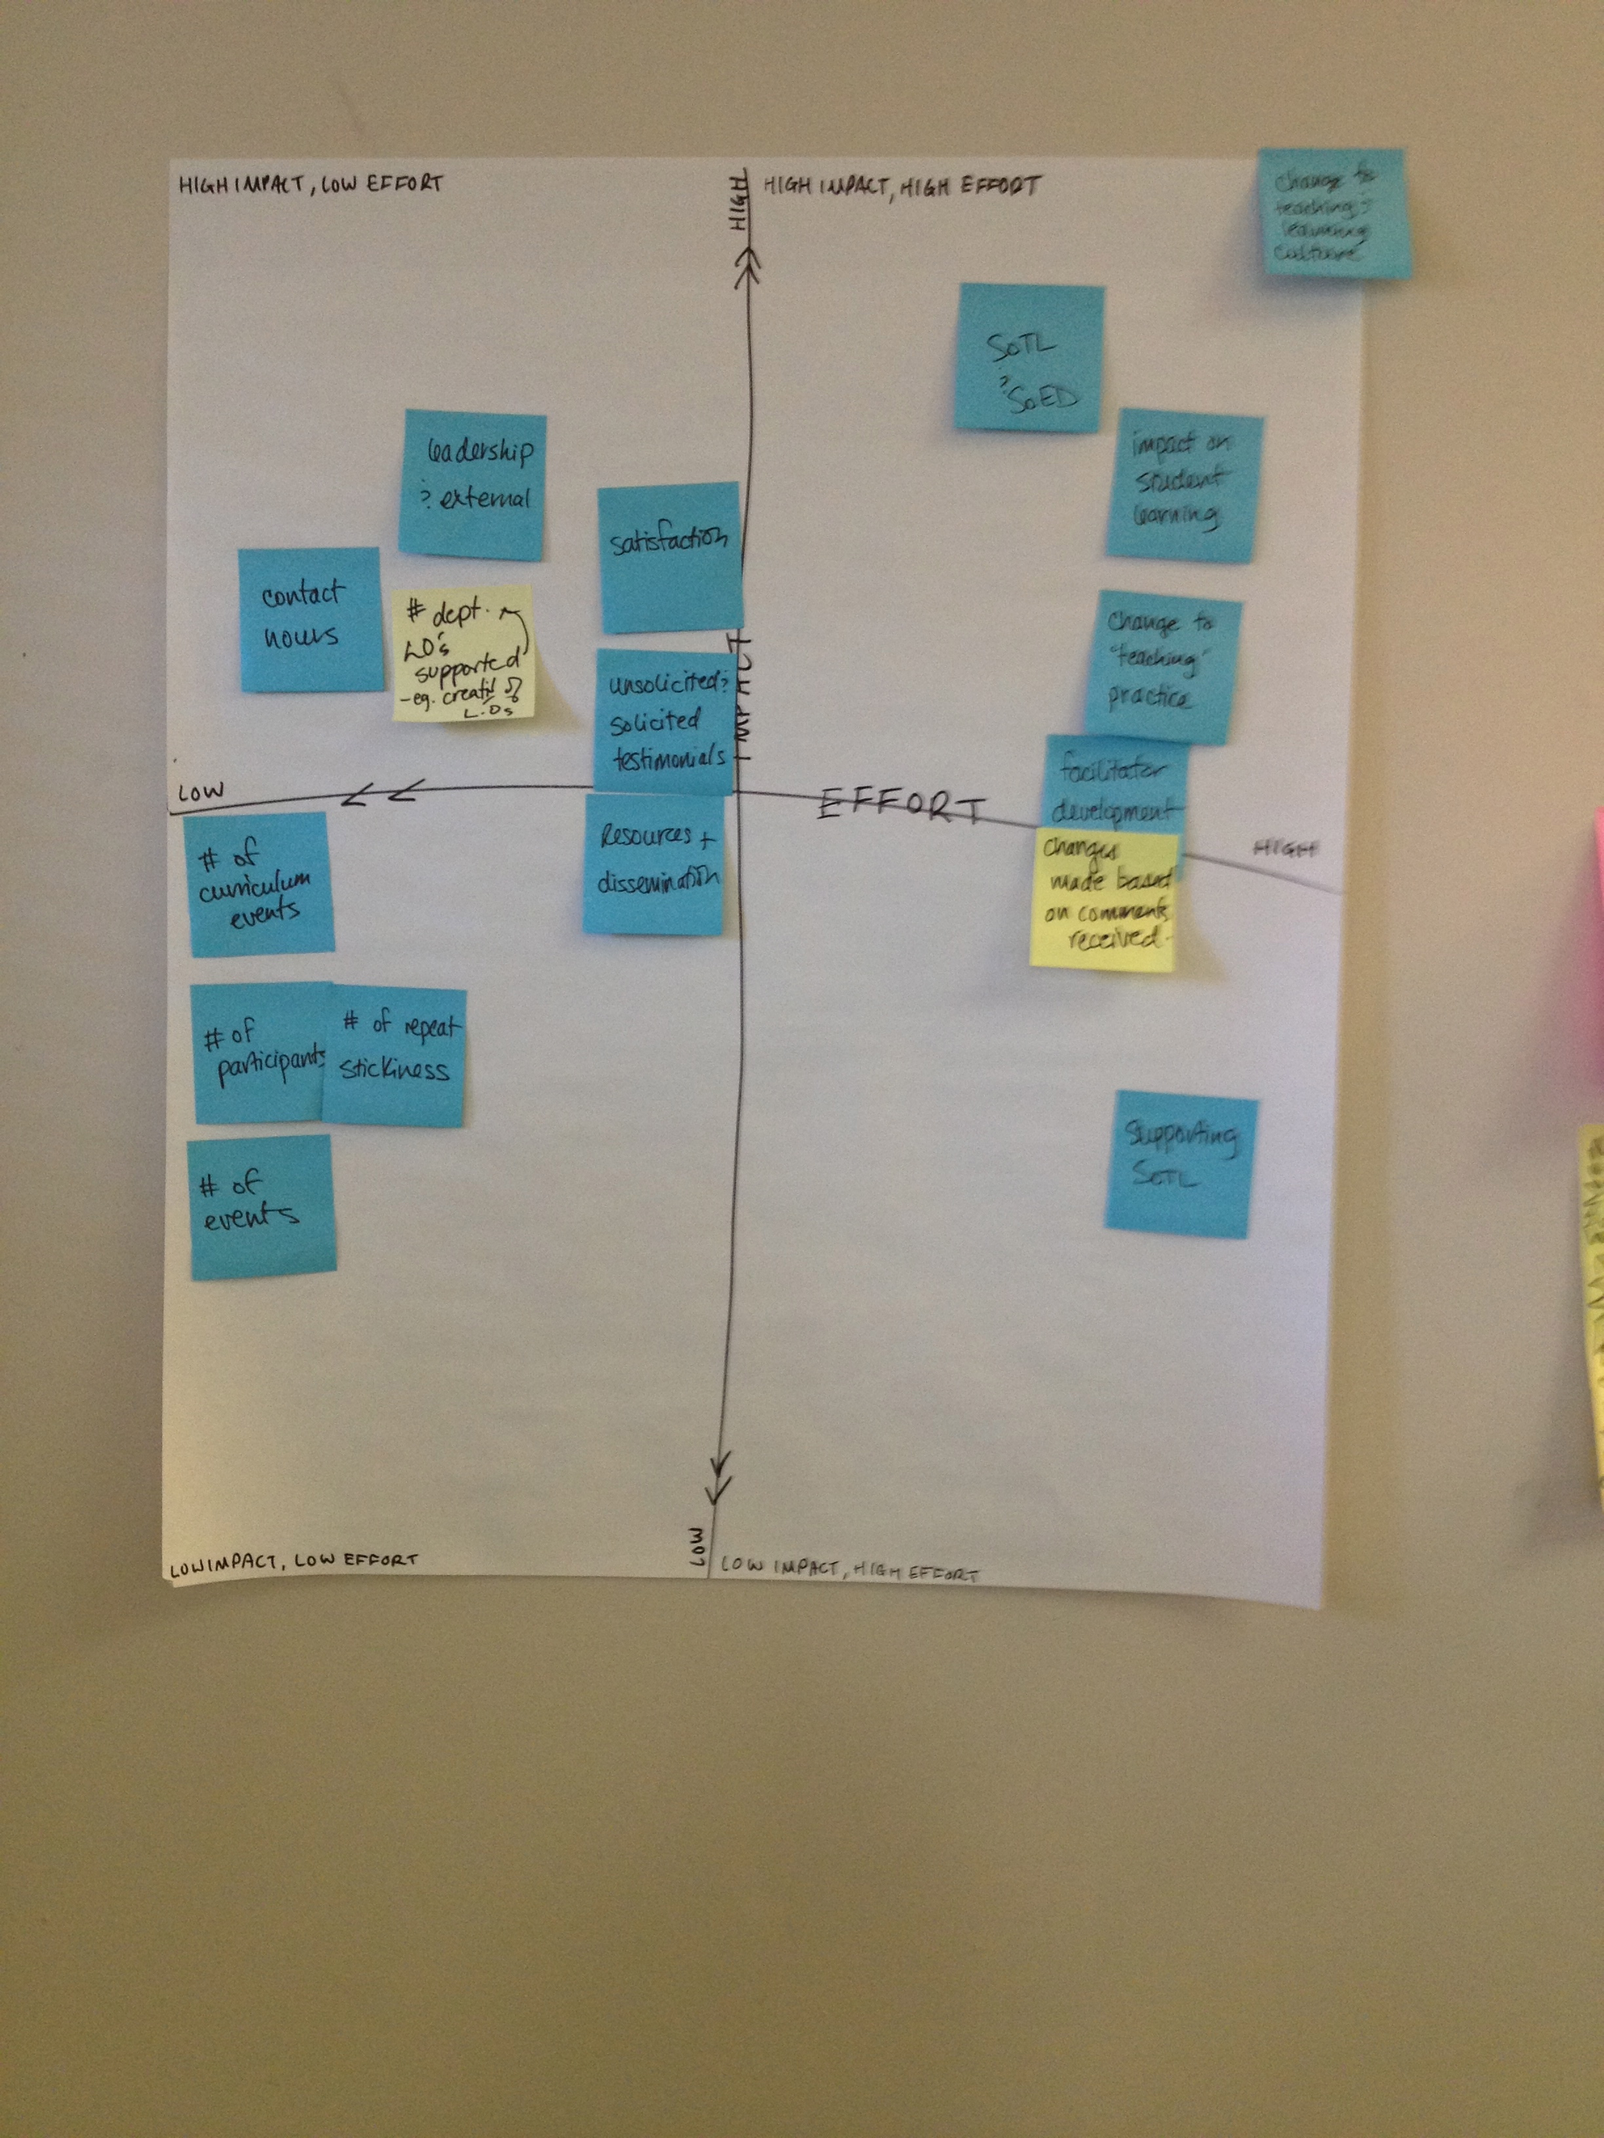
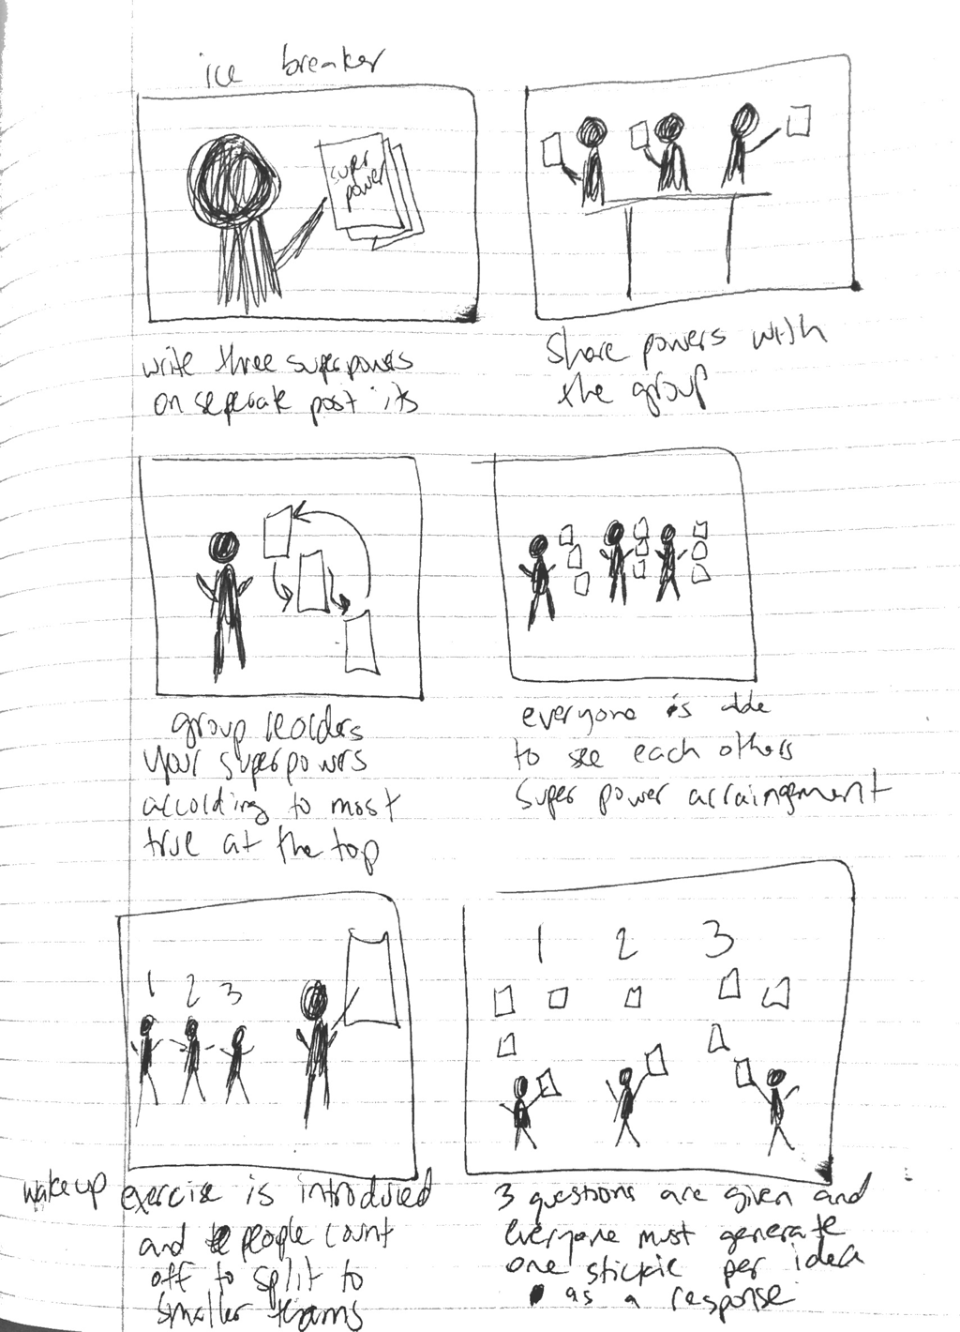
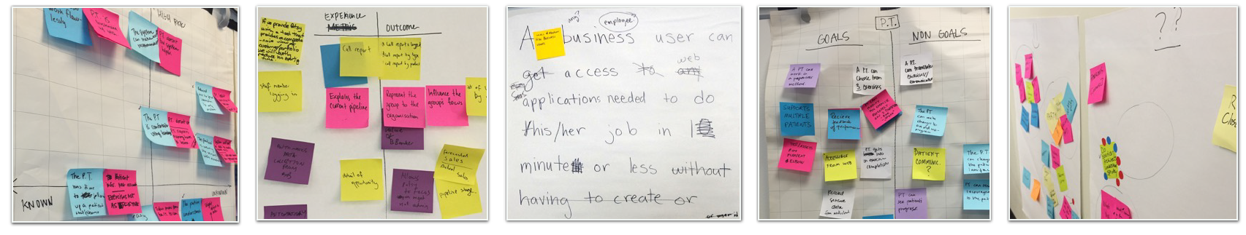
CSMO Design Thinking Workshop
Workshop Activities:
Stakeholder + Empathy Maps
As-Is Scenario
Ideation
Prioritization
Storyboarding
Assumptions
Hypothesis / Metric
MVP
Goals / Non-Goals
Retro

Slide 57
CSMO Design Thinking Workshop
Workshop Goals:
Leverage IBM Design Thinking and CSMO Practice Team subject matter expertise to drive transformation of IT.
Using ‘Personas’ and ‘As-Is Scenario Maps’ gain empathy for and deep understanding of current Services Management pain points.
Using the tools of ‘Ideation’ and ‘Storyboarding’ define future-state for Services Management alleviating current pain points.
Decide upon the one or two things most necessary to enhance and enable your transformation to cloud. This is your ‘MVP’ from an operations perspective and likely includes changes in Process, Culture and/or Technology.
Detail candidate MVP’s Scope/Metrics and Skill/Timeline.
Insights and Learnings captured in a Workshop Outcomes Deck delivered to your team.

Slide 58
Implementation of Selected MVP

Slide 59



Implementation of Selected MVP
Reference Architecture for CSMO
After appropriately sizing and scoping your MVP, Garage Team team drafts a proposal to execute on your MVP and, in collaboration with your team, deploys and instantiates the MVP over the next several weeks.
Process
Continued Availability
Built-to-Manage Approach
Implement New Tools (ChatOps, Runbook Automation)
Tools & Technology
Integrate Cloud Service Management toolchain with existing ITSM landscape
Implement New Roles (Site Reliability Engineer, First Responder)
Culture
Role-based Dashboard for Cloud Service Management

Slide 60
Build to Manage

Slide 61

Operations goals vs development goals
Operations
Minimize risk
Maximum availability
Development
Rapid incremental change
Feedback loop

Slide 62
Possible solutions
Developers support their own code
Opposing goals are owned by the same person, enabling the
individual or team to negotiate a compromise between the two
Broad skill sets required.
DevOps Culture
Create teams with broad mix of skills with the same set of goals
Build to Manage
Activities developers can do to instrument applications or provide
manageability aspects as part of an application release
Notes:
Also in aid of this it is becoming increasingly popular to introduce an Error Budget, recognizing that 100%
availability is not a good target to strive for as it leads to over-caution, and slowing down the introduction of new features which delivers business value.
DevOps is a technique that combines the processes of dynamically creating applications in concert with the processing of deploying and running those applications. While the topic of continued deployment and continued integration is well understood, DevOps also includes aspects to ensure operational excellence which are commonly not given enough emphasis:
• Continuously monitor application status and performance
• Ensure high availability and fast recovery
• Leverage log data to expedite problem identification and resolution
• Shift operational practices to the front of the development cycle to improve reliability
• Cope with the consequence of rapid release cycles
The following development practices ease operations tasks by incorporating aspects like Resiliency in the application architecture.
• The Circuit Breaker pattern
In a cloud application with many interdependent micro-services, use of the Circuit Breaker pattern ensures that a single failure does not take down an entire service.
• Auto-scaling applications
Use auto-scaling for your applications to ensure that enough resources are available at peak timesand to save costs by reducing the allocated resources during times of low usage.
• Automated monitoring
Automated monitoring is the most reliable way to ensure high availability of your applications and reduce downtime.
• Fast recovery
Continuous availability requires a new approach to how applications are developed and deployed. You can use techniques to manage non-disruptive change.
• Resiliency
Traditionally, test scenarios are based on typical product usage patterns, but to expose software flaws, you also have to gracefully handle unstable or unpredictable hardware and test the solution's resiliency to failures.
• Chaotic Testing
Continuously improve stability and recovery time of your production environment by injecting ongoing random failures.
High Availability
To maintain 99.999% availability, the IBM® Bluemix® Garage Method team practices development,
monitoring, and operations techniques for high availability. • Operations Automation
Operations is a costly business. Automation enables you to reduce costs and focus your valuable
staff on higher value tasks.

Slide 63
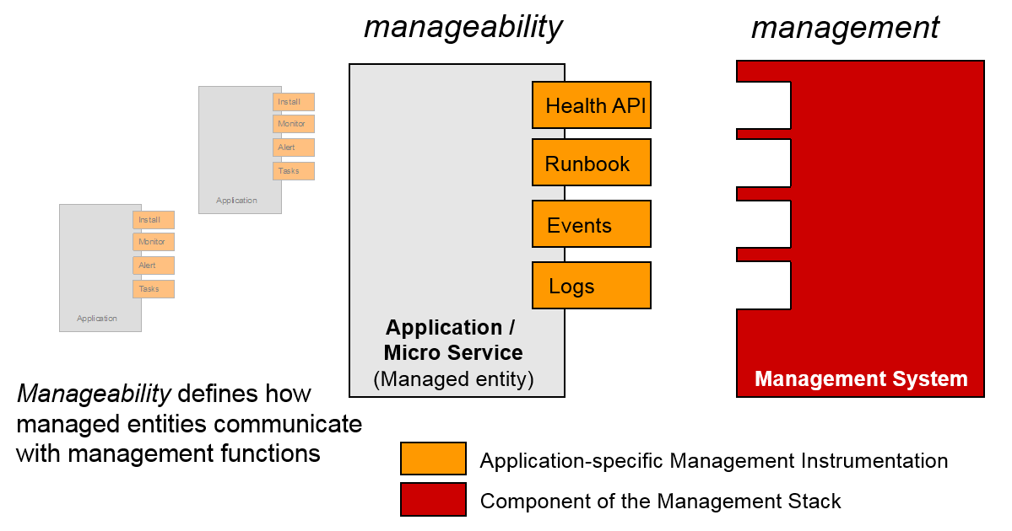
Build to manage approach
Notes:
We all have been there before: Development throws their new code over the wall, and Operations has to figure out how to deploy, how to monitor, how to manage it. In the traditional world, development had time to build this knowledge. Applications were updated rarely, and once deployed the lifetime of the application could span years. As the velocity and speed of change increases, operations teams can become a bottleneck, resulting in either a decelerated release or an increase of operational risks.
Continued Deploy is a key theme in the cloud world, which means that Operations have significant less time to build the knowledge, and the opportunity to apply this knowledge is much shorter. Therefore, we need a different approach to management. Instead of Operations figuring out their tasks in isolation, Development provides information on how to manage the application. In DevOps, developers already took control of one important aspect of operations: Deployment and Release of the application. However, there are more things developers should do to ease operations.
As organizations are working on building out a sustainable culture, we recognize the need for some simple specific steps to follow to start getting some of the benefits in the short term. To this end, we are introducing a new approach to operations which we call Build to Manage. It specifies the practice of activities developers can do in order to instrument the application, or provide manageability aspects as part of an application release.

Slide 64
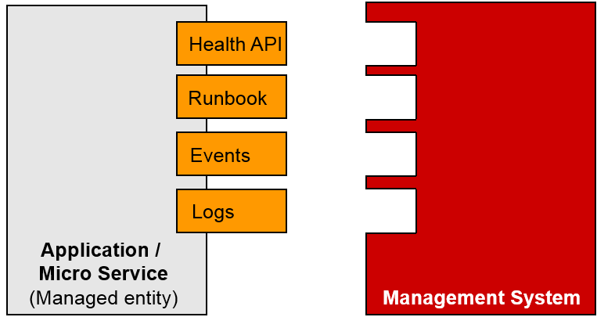
Build to manage aspects
HealthCheck API
Log Format and Catalog
Deployment correlation
Distributed Tracing
Topology Information
Event Format and Catalog
Test Cases and Scripts
Runbooks
First Failure Data Capture

Slide 65
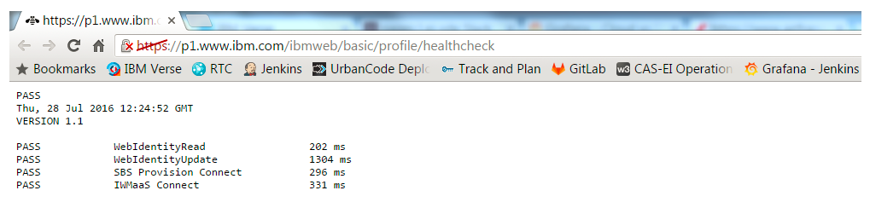

Build To Manage
https://github.com/ibm-cloud-architecture/build-to-manage

Slide 66
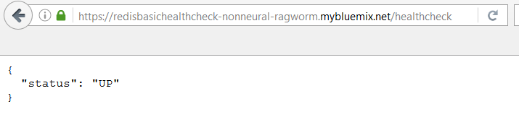
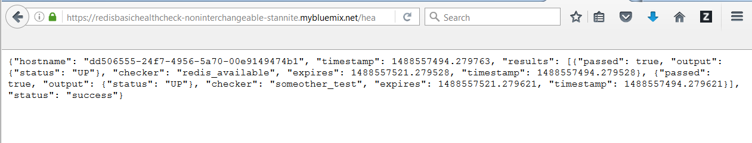
HealthCheck API
A quick, standardized method to validate the status of a component and it’s dependencies
Notes:
With the advent of cloud computing and DevOps practices, monolithic applications are broken into individual components and micro-services. The proliferation of these services imposes a new challenge to the operations team: How to monitor the health of these services in a scalable way?
A HealthCheck API endpoint to a RESTful (micro) service allows a quick, standardized method to validate the status of a component and all its dependencies. As a microservice component has a
relatively small and clearly defined scope, the component owner/developer will be well positioned to understand all the dependencies and how to best validate their availability.
Above is an example of the output of a call to the HealthCheck API of a microservice:
Depending on the deemed state of the dependencies, an appropriate HTTP return code and JSON object should be returned. The response should be explicitly defined as non-cachable to avoid any incorrect status being returned as a result of introduction of caching network equipment or similar. As an example, we may consider a microservice responsible for retrieving user information from a database. The main dependency would be the database where the user entries are stored. In certain cases the microservice may have fall-back mechanisms in place to deal with failures in the primary
data store. This may include slower, less frequently updated tiers of storage, cached results and similar.
It can be beneficial to expose this via an alternate response code, for example 203 “Non-Authoritative
Information”
A health check is a simple ping to a resource of your web application that checks that your application is up and running, responding to network requests, and behaving correctly. It can be as simple as pinging the home page of a web site, checking that the page includes the company's name in the title.
If you have a complex application, there are multiple things that can break independently, and so you want a good health coverage by checking multiple resources (see What Should I Check?).
If your application has got one page that's accessing the database, and another page that just storing requests in a queue, you want to check both
Whether you're using a service like Pingdom or internal tool like Nagios, if you store your checks there, funny thing is they never get updated when you roll out new features.
You want checks to be part of the code base, in source control, right next to the application code that's getting checked, where it can be versioned and code reviewed.

Slide 67

Log Format and Catalog
Generate a unique identifier(UID) on every log entry type
Track the UIDs that you have created in a log catalog
Logging ‘best practices’
Don’t log too much
Don’t log too little
Don’t log everything at the same level
Allow dynamically-changeable and remotely-changeable logging
Include timestamps
Temporary log queues
Log performance data
Create unique identifiers for transactions
Keep multi-line events to a minimum
Add the exact method name / line number to the error message
Notes:
Imagine you have a system, eg. a web server, which processes hundreds of requests per second, each of them producing several log messages. A typical problem you are facing is that the requests overlap and that therefore the log messages are all scrambled together, making them hard to read.
How long does it take to find the root cause of a failure in your system? Five minutes? Five days? If you answered close to five minutes, it’s very likely that your production system and tests have great logging. All too often, seemingly unessential features like logging, exception handling, and (dare I say it) testing are an implementation afterthought. Like exception handling and testing, you really need to have a strategy for logging in both your systems and your tests. Never underestimate the power of logging. With optimal logging, you can even eliminate the necessity for debuggers. Below are some guidelines that have been useful to me over the years.
A production service should have both logging and monitoring. Monitoring provides a real-time view on the system and application state, and alerts you in case a situation is met. In most cases, a monitoring alert is simply a trigger for you to start an investigation. Monitoring shows the symptoms of problems. Logs provide details and state on individual transactions, so you can fully understand the cause of problems.
Logs provide visibility into the behavior of a running app, they are one of the most fundamental tools for debugging and finding issues within your application. Therefore, it is important that the log entries are readable to humans. Avoid using complex encoding that would require lookups to make event information intelligible. At the same time, systems should also be able to parse logfiles easily and rapidly. The way to do this is to generate a unique identifier on every log entry type. Reading and parsing a variety of log entries and a multitude of logfiles of a distributed environment can be made easier by prepending unique identifiers (UID) to each log line.
Logfile parsers can now use the UID to quickly catch those entries you are looking for. Track the UIDs that you have created in a log catalog. This catalog lists all potential UIDs that your
application could emit, plus an explanation with more details on the symptoms and potential root-causes of this log entry being generated. Ideally, you would also specify what action one could take to resolve the issue. These texts elaborate on the message text, and are available in the product's messages publications and in the command line help. This catalog will be used by the DevOps team to configure Logfile Parsers to detect entries and alert upon them. They use the expert advice in this catalog to triage the problem and to resolve the problem.

Slide 68
Deployment correlation
Use Deployment markers to track state of application deployment
Can be used to send notification triggers to management systems
Users can leverage information in dashboards
Marker information can be sent to Event Management system for correlation with other events
Notes:
Use Deployment markers to track state of application deployment. Deployment markers can also be used to send notification triggers to management systems, enabling
them to track when an issue was introduced. After recording deployments, users can leverage the information in operational dashboards, for instance to visually correlate performance distribution and deployment tasks.
Dashboards may also allow to launch in context, to gather more information related to de deployment, for instance retrieving the change log.
Information from deployment marker could further be sent to the Event Management subsystem, so that events can be correlated with deployment activity.

Slide 69
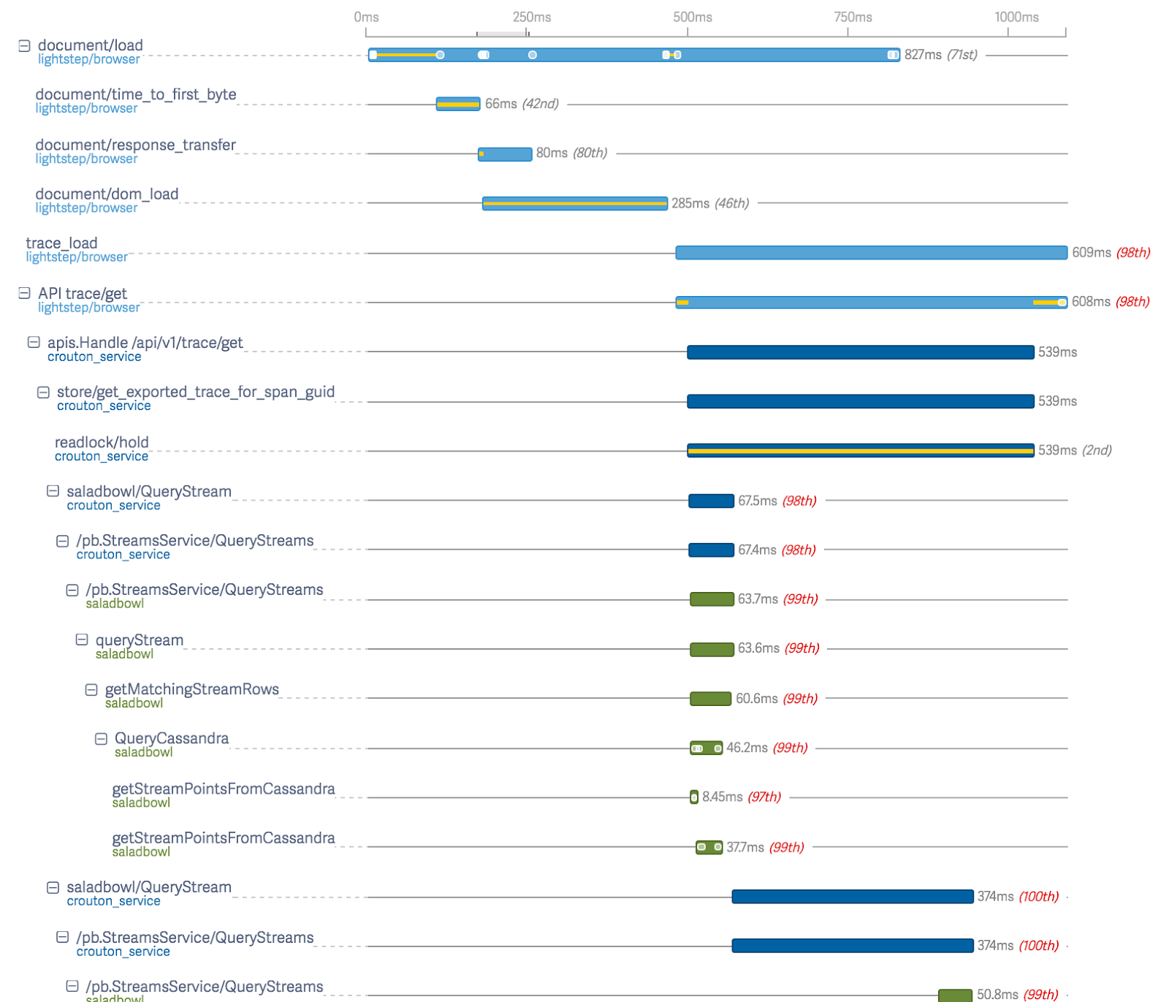
Distributed Tracing
Help to understand how and why complex systems misbehave.
A unique Transaction ID is passed through the call chain of each transaction in a distributed application topology, such as micro services based topologies
Pass the id generated on an entry point to each subsystem that is used
Ideally transparently, via wrapper functions and http headers where possible. .
Helpful for debugging and gathering analytics
Notes:
Moving application architectures from a monolithic design to a micro-service oriented design introduces a number of advantages, both during development and operations phases. However new challenges are introduced as traditional metrics and logs tend to be captured and recorded in a component and machine centric way. The traditional tools used to capture and analyze information becomes powerless when the components are spread across countless machines, multiple physical locations and become subject to highly dynamic horizontal scaling over ephemeral compute units. In the context of server app logs, multiple sessions will output log information that can be intermixed. These sessions can be part of an ongoing process, such as a user interaction with a web site.
Distributed Tracing is a technique where a unique Transaction ID is passed through the call chain of each transaction in a distributed application topology, such as micro services based topologies. Try to pass the id you generated on an entry point to each subsystem that is used to finish the job. Ideally this should be done transparently, via wrapper functions and http headers where possible. This unique ID can be generated at the entry point of the topology, or extracted from an external unique identifier, such as the Cloud Foundry “vcap_request_id”. Unique identifiers such as Transaction IDs and User IDs are tremendously helpful when debugging, and even more helpful when you are gathering analytics. Unique IDs can point you to the exact transaction. Without
them, you might only have a time range to use. When possible, carry these IDs through multiple touch points and avoid changing the format of these IDs between modules. That way, you can track transactions through the system and follow them across machines, networks, and services.
Once the means for generating and carrying this unique ID is implemented, it can be used in several useful ways, for example for Log Correlation, Dependencies Map and Availability Monitoring.
Correlating the captured transaction id together with application/service identification and other meta data makes it possible to build out a topology view, or dependency map of all the services in the topology. Some frameworks and monitoring solutions supports this out of the box, like IBM APM, Zipkin Dependencies and New Relic.

Slide 70
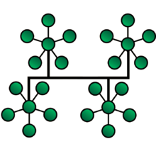
Topology Information
In traditional IT, CMS or CMDB holds Configuration Item (CI) information and relationships between Cis
In cloud, shifts from tangible assets to services and APIs
Relationships and dependencies are important to understand
Recommend developers provide deployment descriptors
Notes:
In traditional IT, a Configuration Management System (CMS, or CMDB) is the cornerstone for many IT processes. It holds information of Configuration Items (CI) as well as relationships between these CIs. In a cloud environment, the focus shifts from tangible assets towards services and APIs. As monolithic applications are broken into a larger set of micro-services, information about relationships and dependencies
becomes even more relevant. Consider worker based systems or a system composed from several microservices. Performance deterioration in one micro-service may result in slow performance for depending micro-services and eventually the business application. Practices like the “Circuit-Breaker” pattern exist to workaround these issues, but from an operations perspective the need for visibility and control still exists.
Some of the information can be discovered at runtime, for instance by calling Cloud Foundry APIs to query which services are bound or instantiated or information on containers and container groups. However, some information is not discoverable. We postulate a practice where the developer of a micro service also provides meta-information on the topology / call-chain: What services does this micro-service depend on?
A Deployment Descriptor is a configuration file for an artifact that is deployed to an environment (container, engine, etc.). It directs a deployment tool to deploy a module or application with specific container options, security settings and describes specific configuration requirements. Even if your deployment tool is currently not able to pick up all parameters, it is recommended to specify the dependencies as you develop the application.

Slide 71
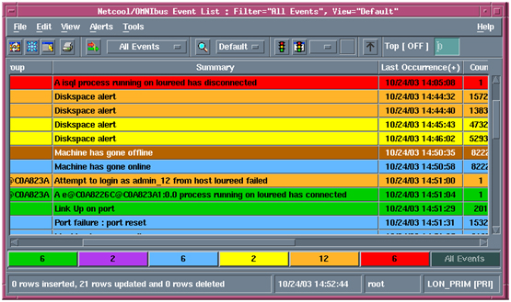
Event Format and Catalog
Events should provide relevant data as part of their payload to allow for correlation of multiple events
Application names or
Identifiers
Transaction identifiers, or information
Topology information
Notes:
Particular focus should be paid to the ability to correlate multiple events. In order to enable and ease correlation, events should provide relevant data as part of their payload. Examples are application names or identifiers, transaction identifiers, or information that links to topology and containment data. Many of the concepts discussed in the chapter on Logs apply to events as well. For instance, every event should be well defined using a unique identifier. As these concepts were already discussed in the previous chapter, we are not repeating these and refer to the information on logs.

Slide 72
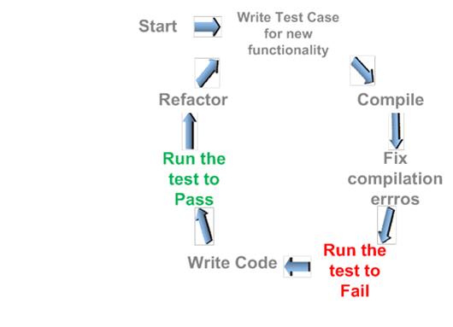
Test Cases and Scripts
Test Driven Development
Requirements turned into test cases
Software is built to pass the tests
Developer responsible for test cases and scripts
Test code treated like production code
Must work correctly for both positive and negative cases

Slide 73

Runbooks
Compilation of routine procedures and operations that the system administrator or operator carries out
Electronic or in physical book form
Typically contains procedures to begin, stop, supervise, and debug the system
Notes:
In a computer system or network, a runbook is a compilation of routine procedures and operations that the system administrator or operator carries out. System administrators in IT departments and NOCs use runbooks as a reference. Runbooks can be in either electronic or in physical book form. Typically, a runbook contains procedures to begin, stop, supervise, and debug the system. It may also describe procedures for handling special requests and contingencies. An effective runbook allows other operators, with prerequisite expertise, to effectively manage and troubleshoot a system. Through runbook automation, these processes can be carried out using software tools in a predetermined manner.
Runbooks are typically created by technical writers working for top tier managed service providers. They include procedures for every anticipated scenario, and generally use step-by-step decision trees to determine the effective response to a particular scenario.
Runbook applied to operations
Operational runbooks may be tied to IT Infrastructure Library (ITIL) incidents to allow repeatable processes supporting specific aspects of the service catalog.^{[1]} The runbook is typically divided into routine automated processes and routine manual processes. The runbook catalog begins with an index of processes covered and may be broken down in outline form (e.g. 1, 1.1, 1.1.1) to align the processes to the major elements they support in the service catalog.
Runbook automation (RBA) is the ability to define, build, orchestrate, manage, and report on workflows that support system and network operational processes. A runbook workflow can potentially interact with all types of infrastructure elements, such as applications, databases, and hardware.
According to Gartner, the growth of RBA has coincided with the need for IT operations executives to enhance IT operations efficiency measures—including reducing mean time to repair (MTTR), increasing mean time between failures (MTBF), and automating the provisioning of IT resources. In addition, it is necessary to have the mechanisms to implement best practices (for example, implement and manage IT operations processes in line with the ITIL, increase the effectiveness of IT personnel (for example, automate repetitive tasks associated with IT operations processes), and have the tools to report on how well the processes are executed in line with established policies and service levels.
Runbook Automation is an effective way to optimized the error budget: Runbooks codify the individual steps to be executed, allowing an automated execution of these steps. Further, the execution of these runbooks could be triggered automatically, reducing the wait time until actions are initiated. As the developer is working specific functionality and around the time when tests are being written for a service may be a particularly good time for also addressing Runbooks. Automating tasks through Runbook Automation can also show very effective in making savings form the error budget. So rather than expecting Operations to develop the runbooks, the recommended strategy is that Developers provide relevant runbooks as part of the code delivery. Operations can further create additional runbooks or improve existing ones as part of a continued service improvement initiative.

Slide 74

First Failure Data Capture
Instantly capture useful data after a problem has been logged
Collect enough data so that a problem can be diagnosed without having to reproduce it
Can include trace logs, message logs, dumps of in-memory data structures, and so forth.

Slide 75
Where to start – some recommendations
Mature organization, majority of infrastructure in traditional IT
Runbooks
Log Format and Catalog
Event Format and Catalog
Emerging organization, Cloud Foundry/Bluemix based infrastructure
HealthCheck API
Log Format and Catalog
Test cases and scripts
Aggressively adopting microservices
HealthCheck API
Distributed Tracing
Topology Information
Deployment Correlation
Notes:
The proposed nine practices give a framework for the Build To Manage approach. Where to start depends on the maturity of the organization, as well as the technical foundation.
Here are some recommendations where to start.
In order to assure that the Build To Manage approach reveals business value, these critical success factors
need to be considered
• Prioritization based on business need. The BTM approach consists of 9 practices, but not every practice is evenly important. Depending on existing pain-points and bottlenecks, identify those
practices that show the biggest value.
• Start with the implementation of a minimum viable product (the “cup-cake” step) for the identified
practices, and reiterate quickly.
• A decision on breadth vs. depth needs to follow: will the inclusion of a new practice or the refinement of an existing practice provide more business value?
• Strong management support enforcing the need for operational excellence spanning development and operations teams.
• Implementation of Feedback loops to fine-tune the BTM practices based on user feedback and business priorities
• Identification of Sponsor Teams that pilot the approach. Carefully pick the right teams that have wide recognition in the firm, acting as role models to influence the change

Slide 76
Do Hands-on lab

Slide 77
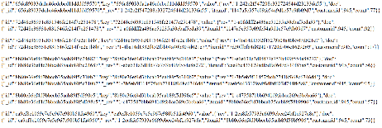




Sample Application
Order(ms)
UI
Cloudant DB
Catalog(ms)

Slide 78

Introduction to Sample Application

Slide 79
Pipelines and stages
Space: dev
Space: qa
Space: prod
Order
Order
Order
Order
SCM
Build
Deploy
Deploy
Deploy
Simple Test
Catalog
Catalog
Catalog
Catalog
SCM
Build
Deploy
Deploy
Deploy
Unit Test
Functional Test
Simple Test
UI
UI
UI
UI
SCM
Build
Deploy
Deploy
Deploy
Simple Test

Slide 80
Pipelines and stages
Stage
Stage
Stage
Stage
Space: dev
Space: qa
Space: prod
Order
Order
Order
Order
GitHub
Build
Deploy
Deploy
Deploy
Simple Test
Catalog
Catalog
Catalog
Catalog
GitHub
Build
Deploy
Deploy
Deploy
Unit Test
Functional Test
Simple Test
UI
UI
UI
UI
GitHub
Build
Deploy
Deploy
Deploy
Simple Test
Job

Slide 81

Toolchain Template

Slide 82

Bluemix Navigation

Slide 83

DevOps Services
1
2

Slide 84

Applications
1
2

Slide 85
References
Optimal Logging: https://testing.googleblog.com/2013/06/optimal-logging.html
Open Tracing: https://www.cncf.io/blog/2016/10/20/opentracing-turning-the-lights-on-for-microservices/
Build to Manage: https://github.com/ibm-cloud-architecture/build-to-manage
Bluemix Garage: https://www.ibm.com/devops/method/category/manage

Slide 86
Notices and disclaimers
Copyright © 2017 by International Business Machines Corporation (IBM). No part of this document may be reproduced or transmitted in any form without written permission from IBM.
U.S. Government Users Restricted Rights — use, duplication or disclosure restricted by GSA ADP Schedule Contract with IBM.
Information in these presentations (including information relating to products that have not yet been announced by IBM) has been reviewed for accuracy as of the date of initial publication and could include unintentional technical or typographical errors. IBM shall have no responsibility to update this information. This document is distributed “as is” without any warranty, either express or implied. In no event shall IBM be liable for any damage arising from the use of this information, including but not limited to, loss of data, business interruption, loss of profit or loss of opportunity. IBM products and services are warranted according to the terms and conditions of the agreements under which they are provided.
IBM products are manufactured from new parts or new and used parts. In some cases, a product may not be new and may have been previously installed. Regardless, our warranty terms apply.”
Any statements regarding IBM's future direction, intent or product plans are subject to change or withdrawal without notice.
Performance data contained herein was generally obtained in a controlled, isolated environments. Customer examples are presented as illustrations of how those customers have used IBM products and the results they may have achieved. Actual performance, cost, savings or other results in other operating environments may vary.
References in this document to IBM products, programs, or services does not imply that IBM intends to make such products, programs or services available in all countries in which IBM operates or does business.
Workshops, sessions and associated materials may have been prepared by independent session speakers, and do not necessarily reflect the views of IBM. All materials and discussions are provided for informational purposes only, and are neither intended to, nor shall constitute legal or other guidance or advice to any individual participant or their specific situation.
It is the customer’s responsibility to insure its own compliance with legal requirements and to obtain advice of competent legal counsel as to the identification and interpretation of any relevant laws and regulatory requirements that may affect the customer’s business and any actions the customer may need to take to comply with such laws. IBM does not provide legal advice or represent or warrant that its services or products will ensure that the customer is in compliance with any law.

Slide 87
Notices and disclaimers continued
Information concerning non-IBM products was obtained from the suppliers of those products, their published announcements or other publicly available sources. IBM has not tested those products in connection with this publication and cannot confirm the accuracy of performance, compatibility or any other claims related to non-IBM products. Questions on the capabilities of non-IBM products should be addressed to the suppliers of those products. IBM does not warrant the quality of any third-party products, or the ability of any such third-party products to interoperate with IBM’s products. IBM expressly disclaims all warranties, expressed or implied, including but not limited to, the implied warranties of merchantability and fitness for a particular, purpose.
The provision of the information contained herein is not intended to, and does not, grant any right or license under any IBM patents, copyrights, trademarks or other intellectual property right.
IBM, the IBM logo, ibm.com, Aspera®, Bluemix, Blueworks Live, CICS, Clearcase, Cognos®, DOORS®, Emptoris®, Enterprise Document Management System™, FASP®, FileNet®, Global Business Services®, Global Technology Services®, IBM ExperienceOne™, IBM SmartCloud®, IBM Social Business®, Information on Demand, ILOG, Maximo®, MQIntegrator®, MQSeries®, Netcool®, OMEGAMON, OpenPower, PureAnalytics™, PureApplication®, pureCluster™, PureCoverage®, PureData®, PureExperience®, PureFlex®, pureQuery®, pureScale®, PureSystems®, QRadar®, Rational®, Rhapsody®, Smarter Commerce®, SoDA, SPSS, Sterling Commerce®, StoredIQ, Tealeaf®, Tivoli® Trusteer®, Unica®, urban{code}®, Watson, WebSphere®, Worklight®, X-Force® and System z® Z/OS, are trademarks of International Business Machines Corporation, registered in many jurisdictions worldwide. Other product and service names might be trademarks of IBM or other companies. A current list of IBM trademarks is available on the Web at "Copyright and trademark information" at: www.ibm.com/legal/copytrade.shtml.

Slide 88
Thank you!

